Slide 1
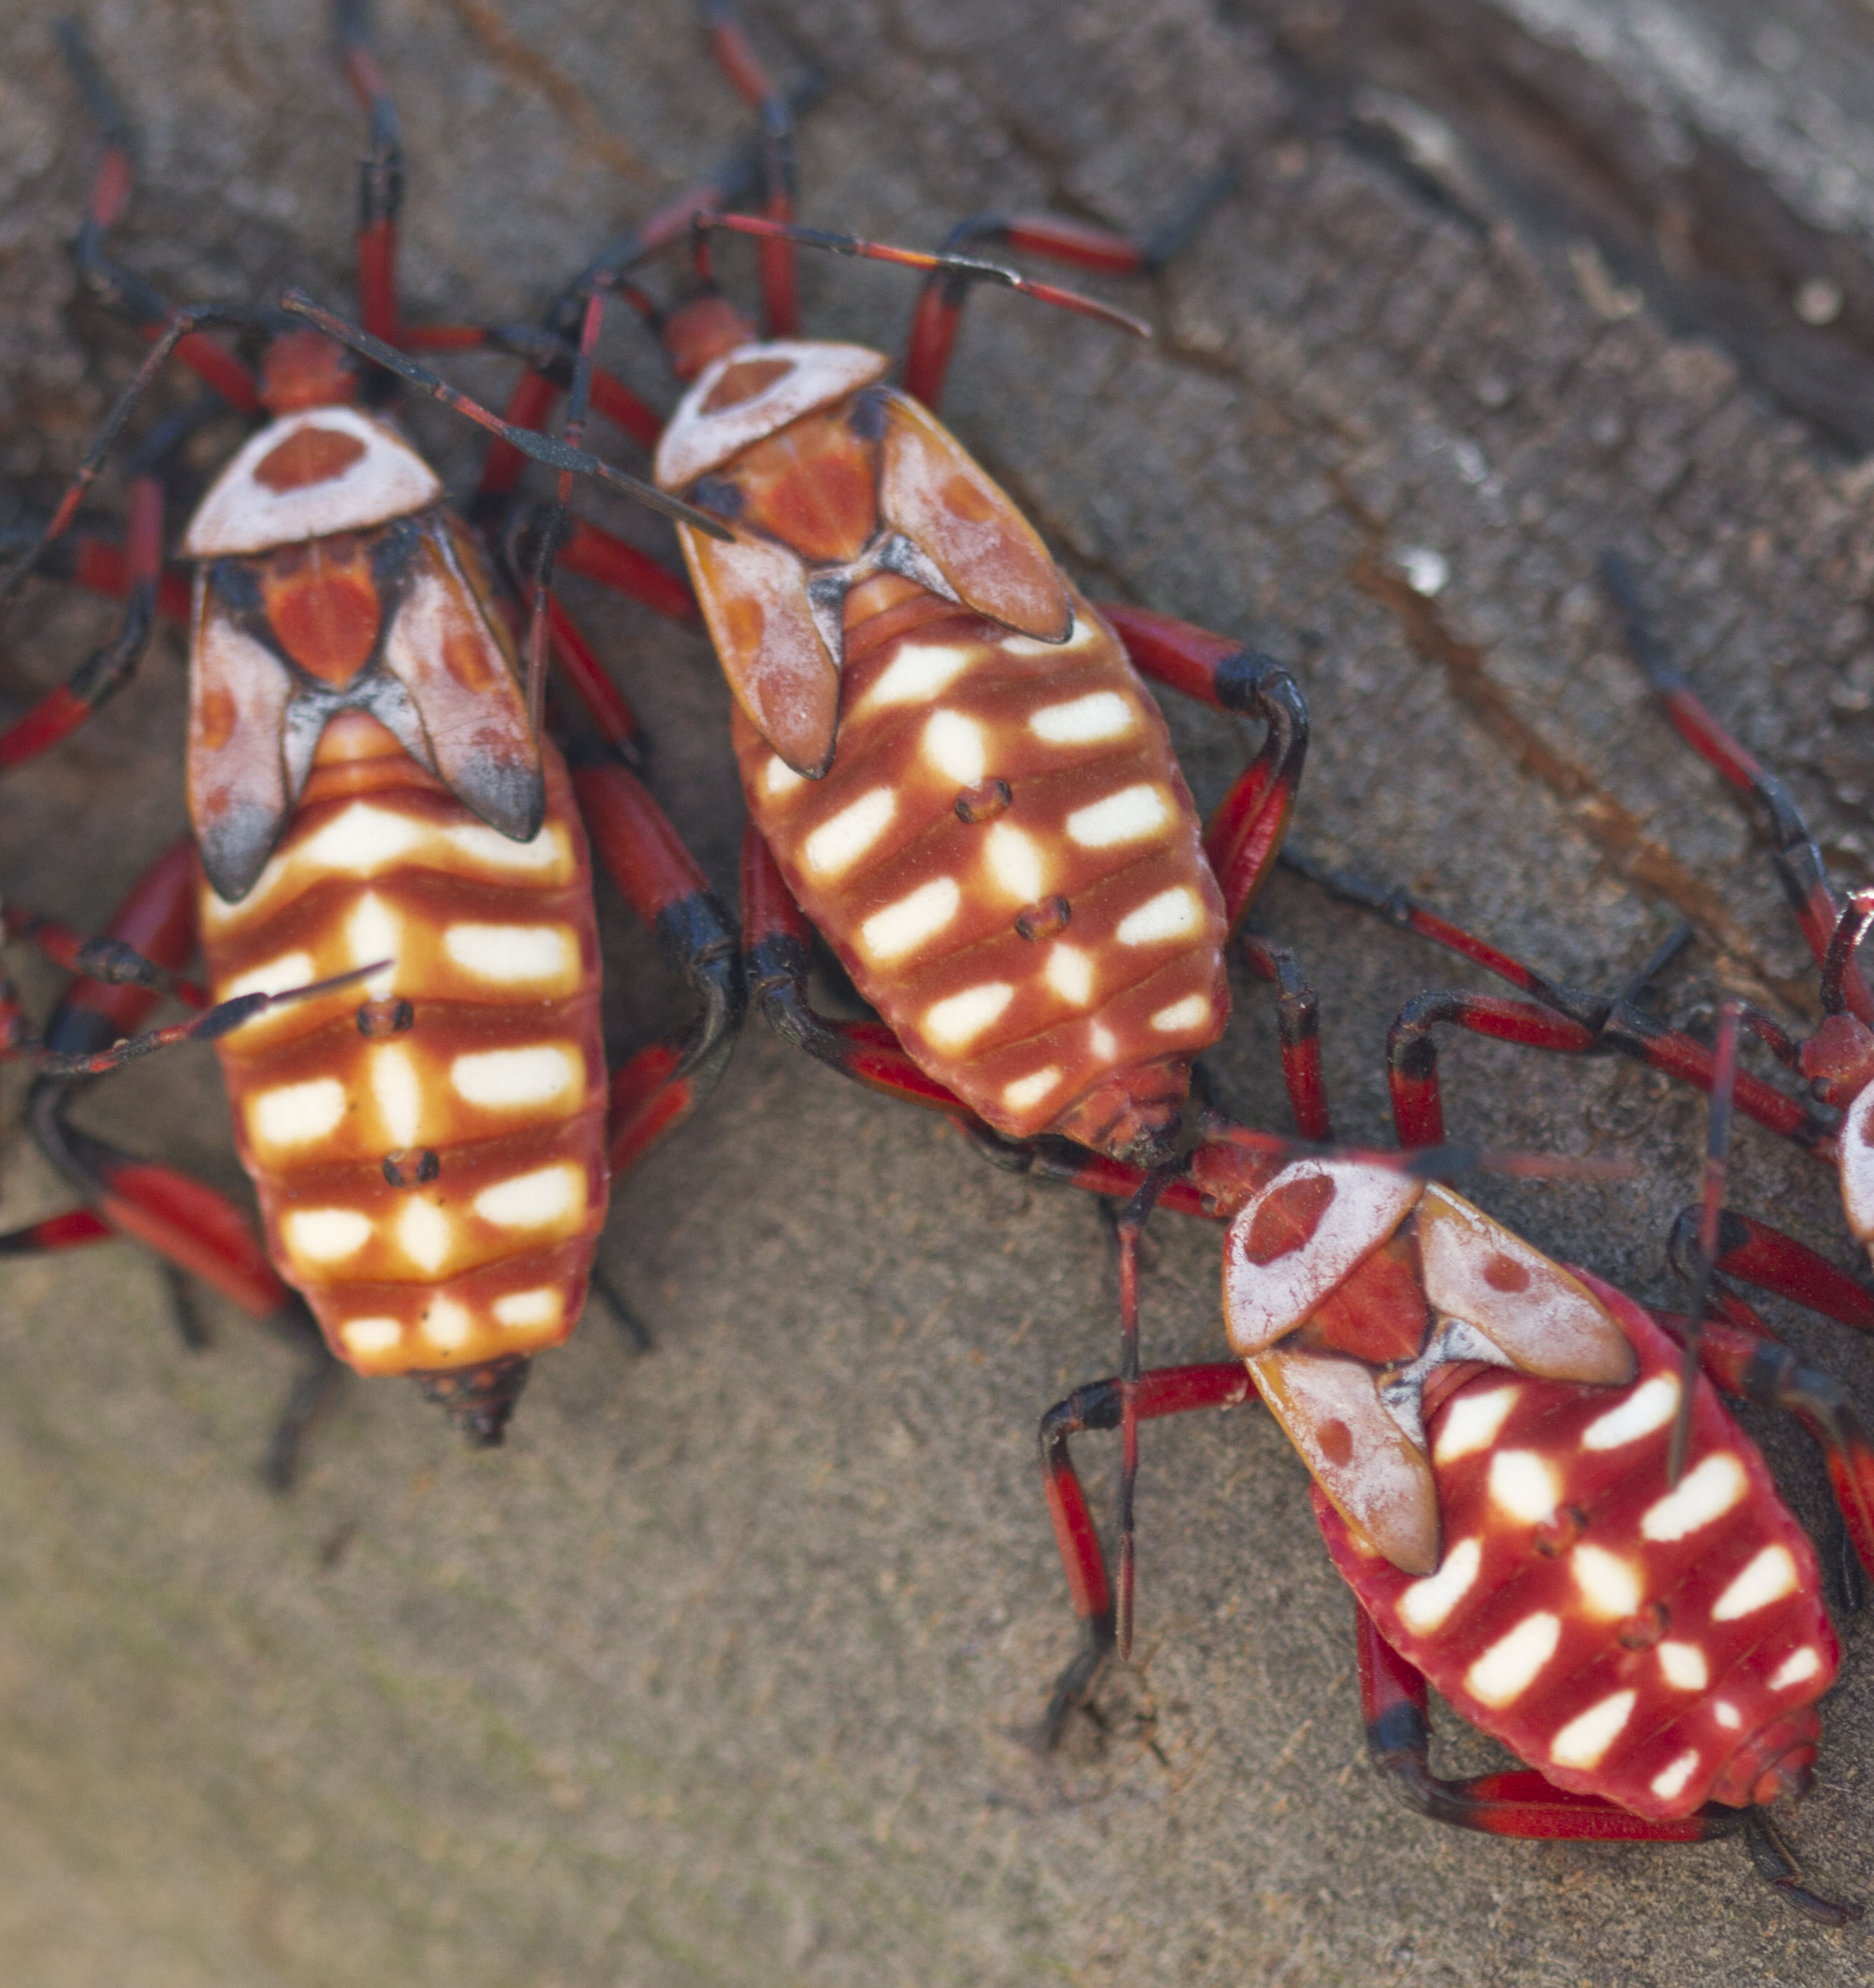
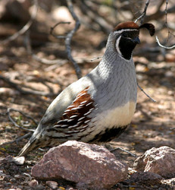
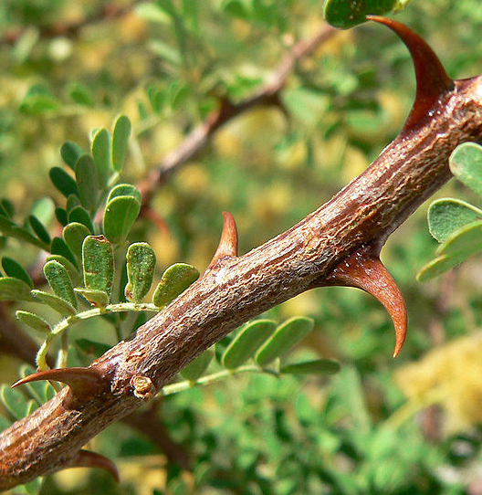
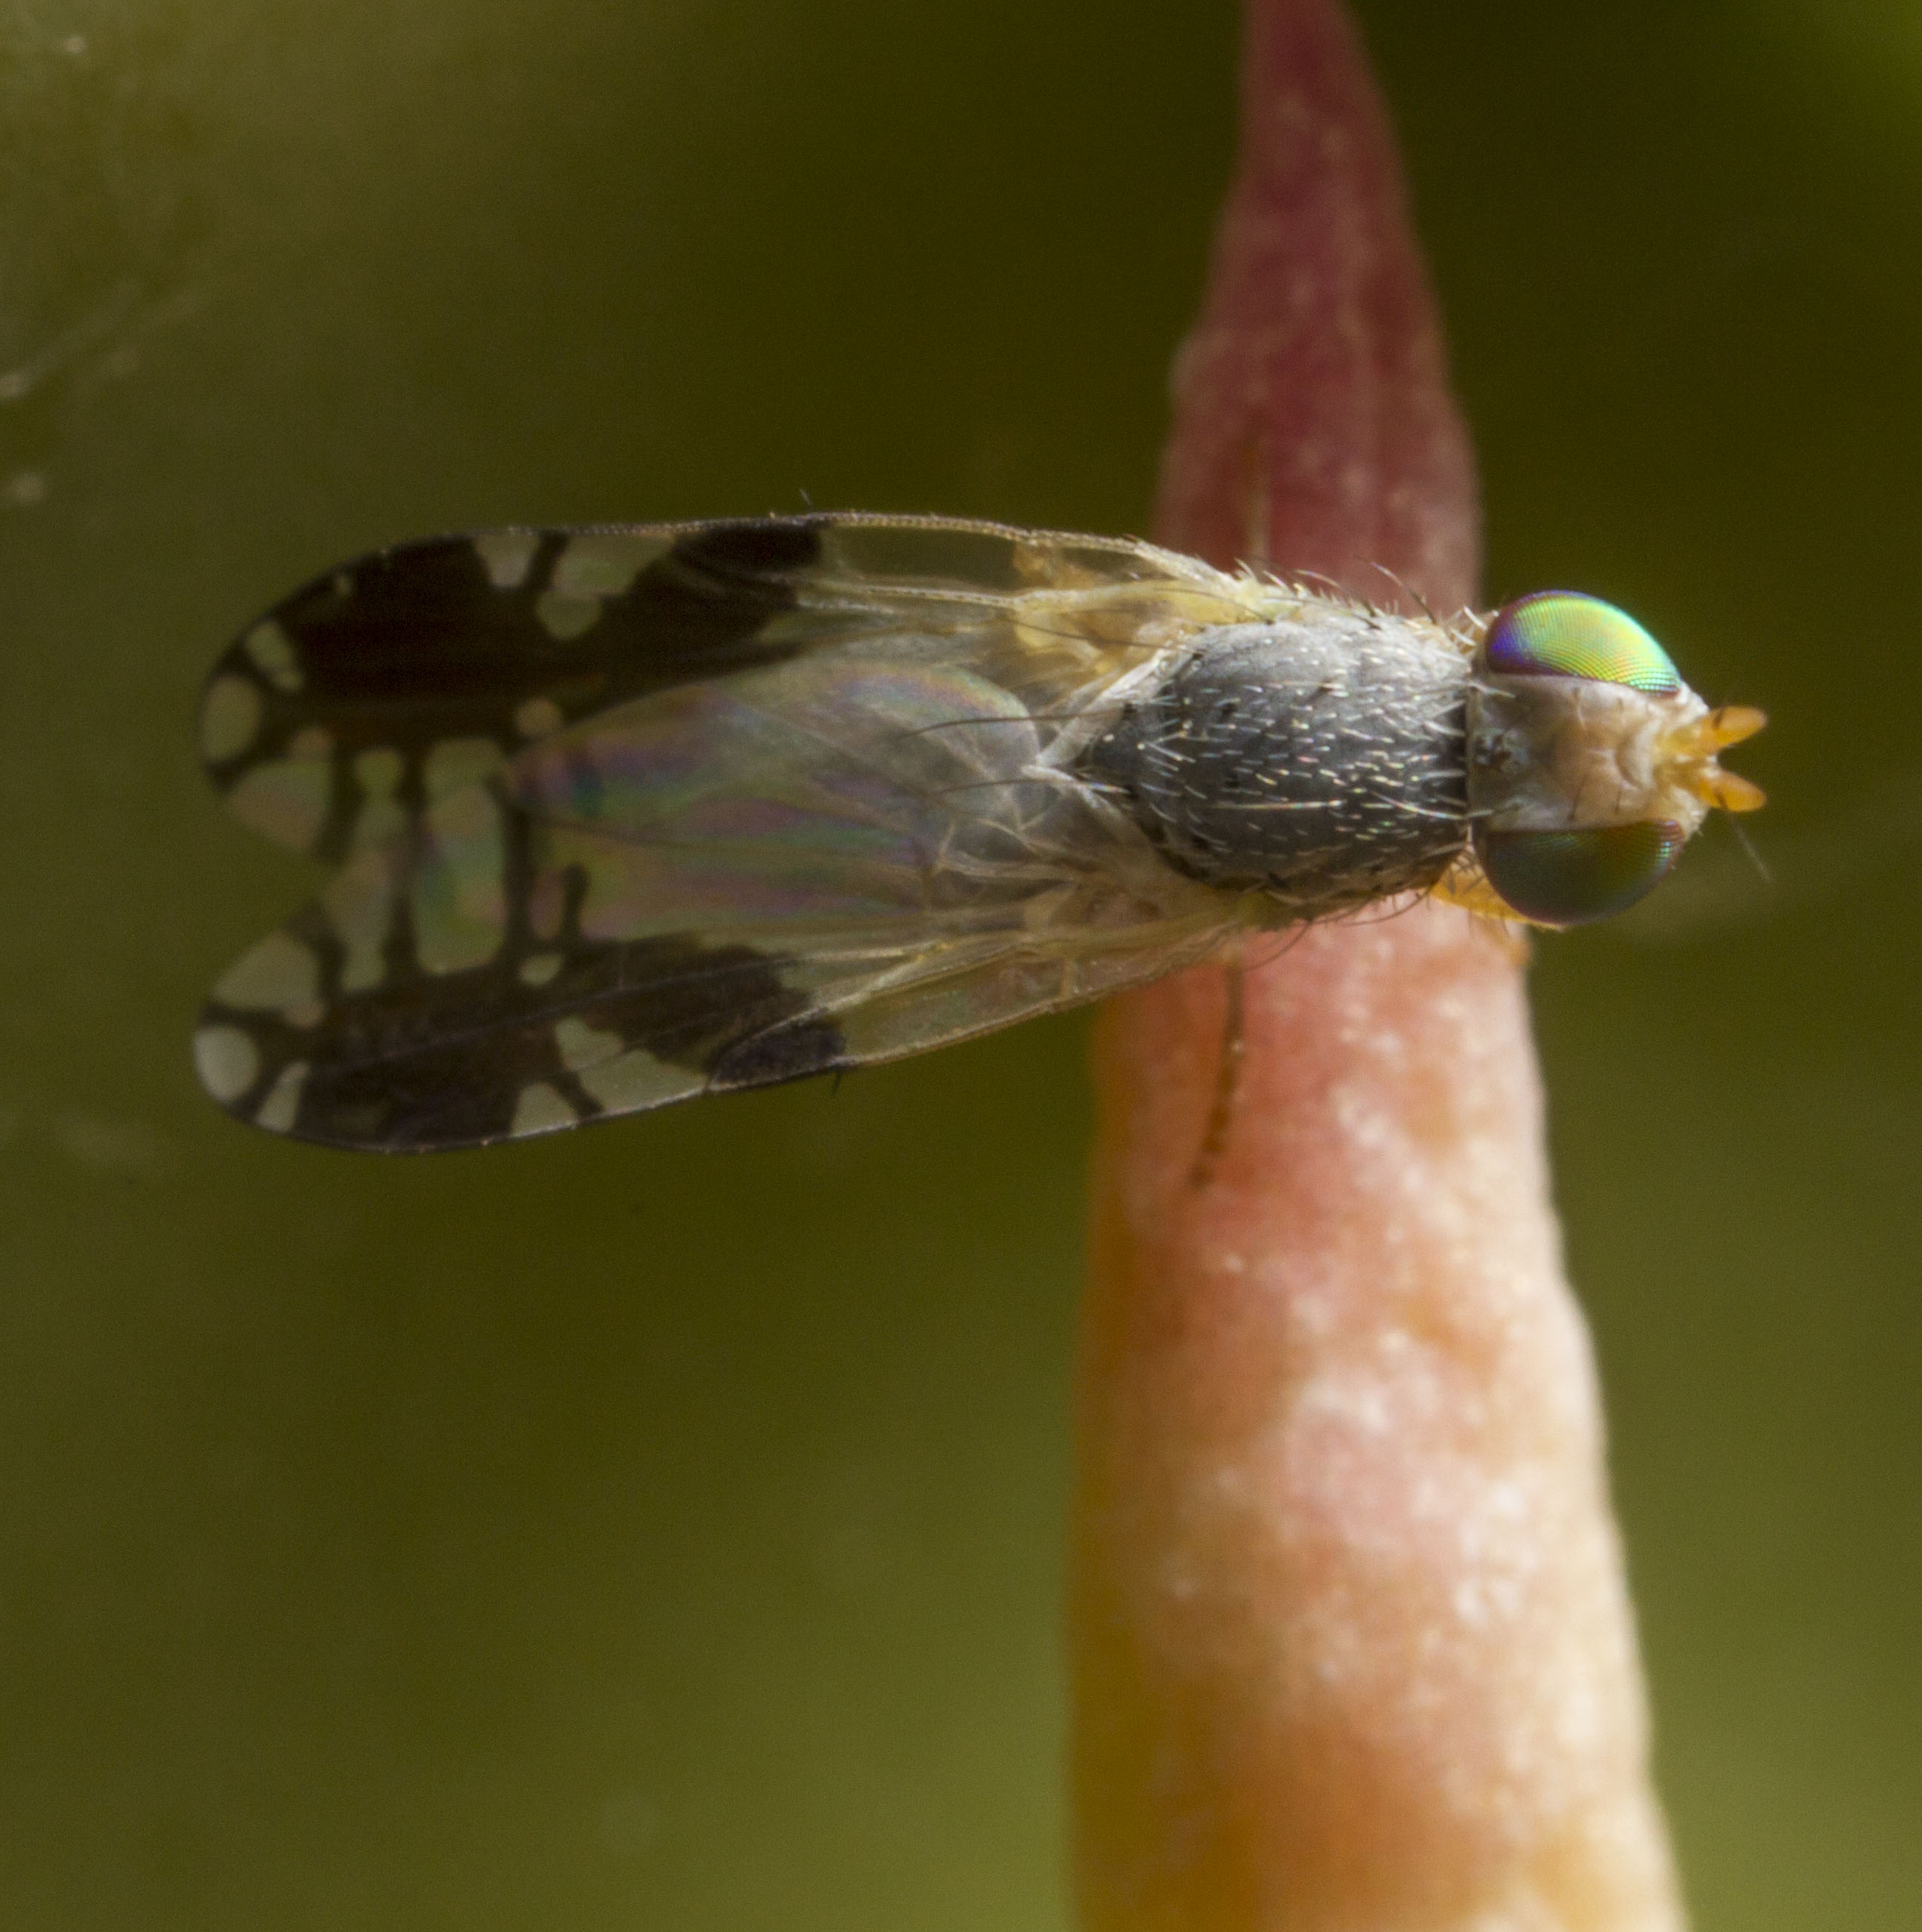
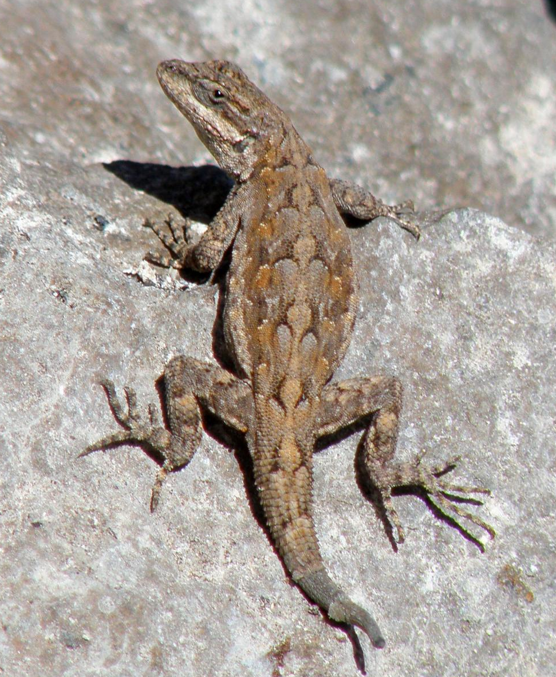
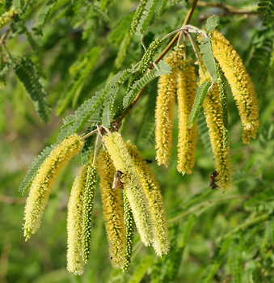
The Schoolyard Bioblitz!
Kim Franklin, Ph. D.
Research Scientist
Arizona-Sonora Desert Museum

Slide 2
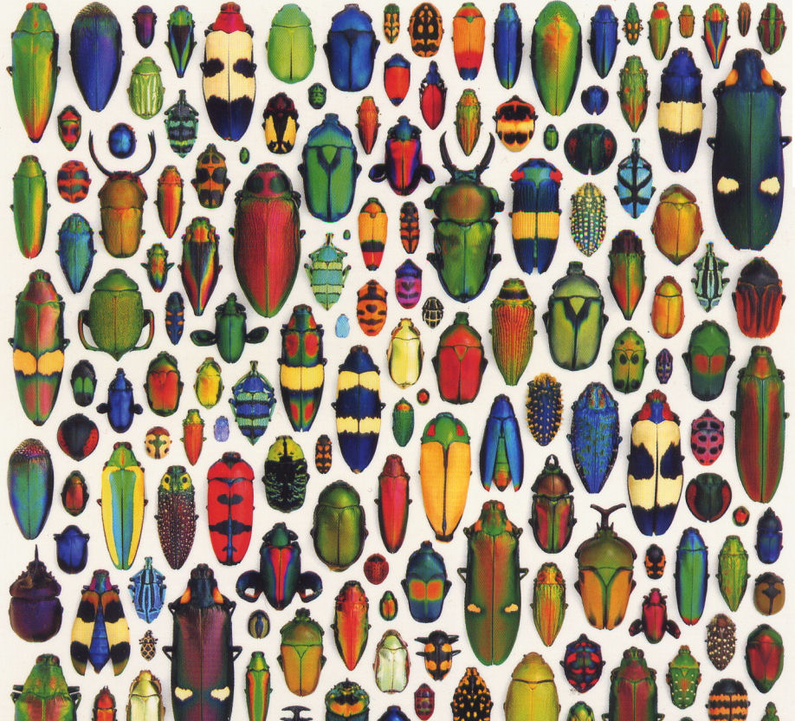
Biodiversity
Notes:
What is biodiversity? The simplest answer is the variety of life on earth. Scientists consider biodiversity to have three primary components, which we’ll talk about on the next three slides.

Slide 3
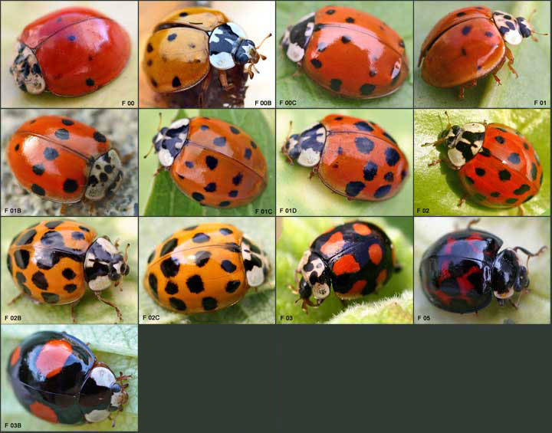
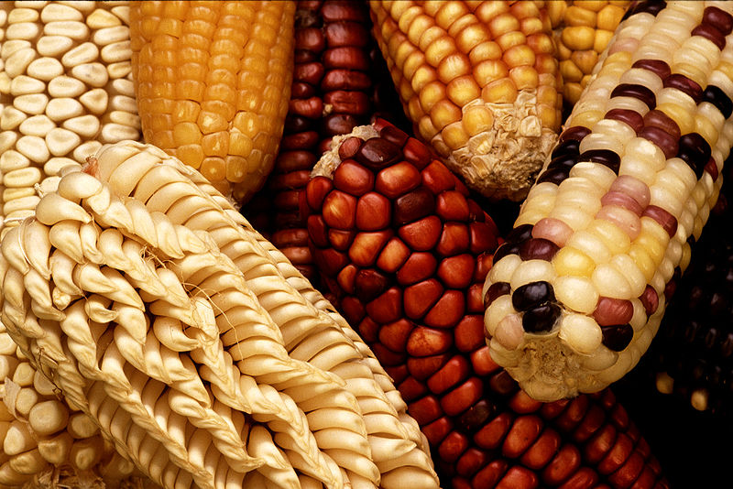
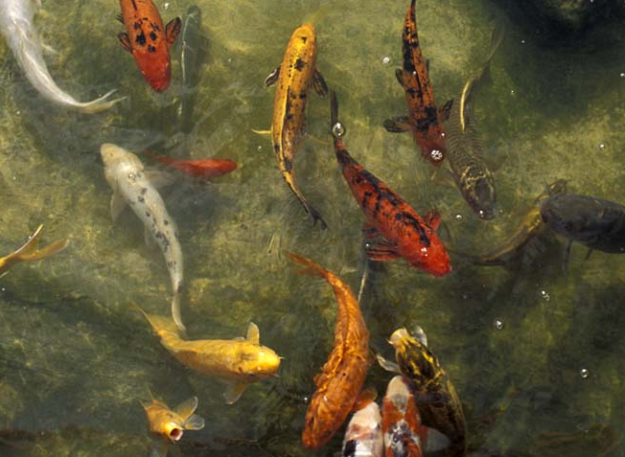
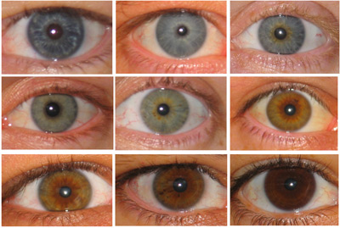
Genetic Diversity
Genetic Diversity
Notes:
(1) Genetic diversity – the diversity within our genomes that provides us with variation among and within species. All people are are not the same – genetic differences lead to differences in eye color, etc. Consider corn, there are many varieties of corn, all the same species, but different varieties come in different colors, textures, ability to resist pathogens, etc.

Slide 4
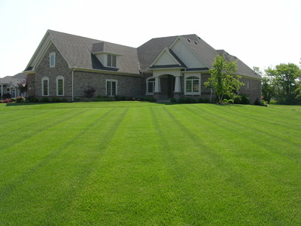
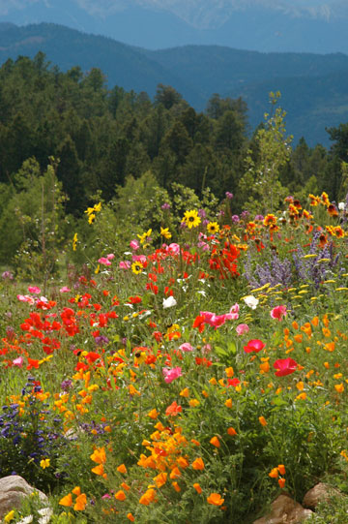
Species Diversity
Species Diversity
Notes:
(2) Species diversity is the simplest conceptualization of biodiversity. It’s simply the number of species in a given area and given time. When we conduct a bioblitz, we are focused on species diversity.

Slide 5
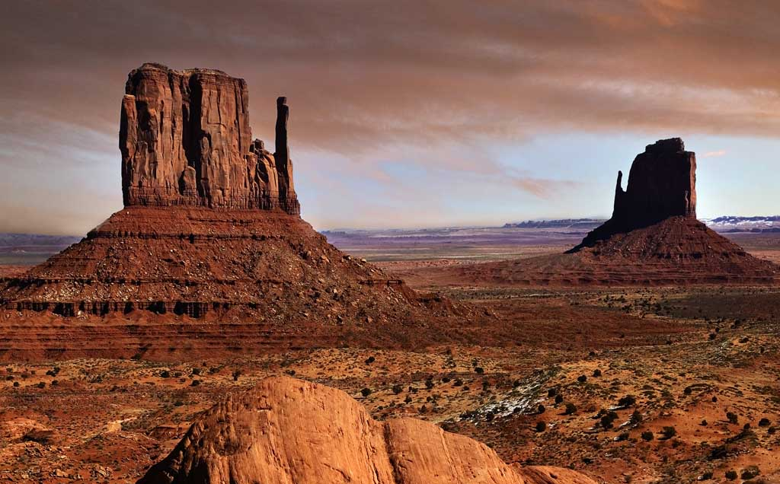
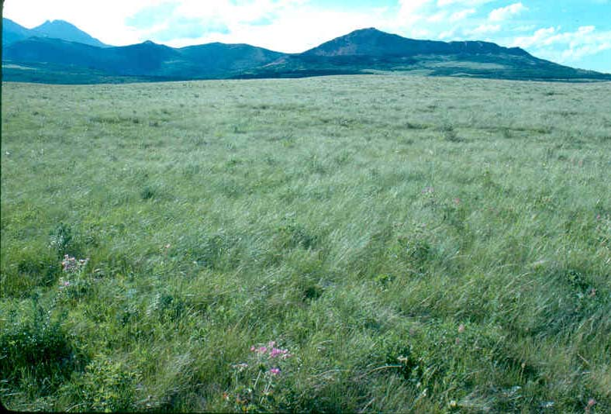
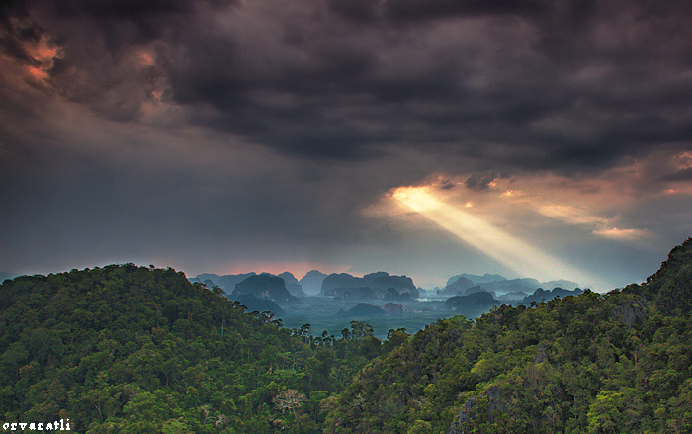
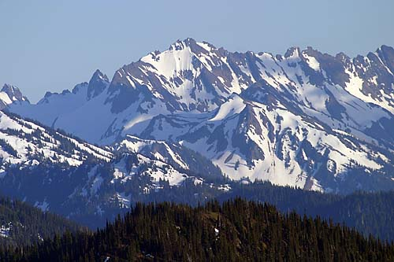
Ecosystem Diversity
Ecosystem Diversity
Notes:
(3) Ecosystem diversity is the incredible variety of ecosystems found across our planet. Some parts of the planet hold a greater number of types of ecosystems than others. What types of ecosystems can you find in southern Arizona?

Slide 6
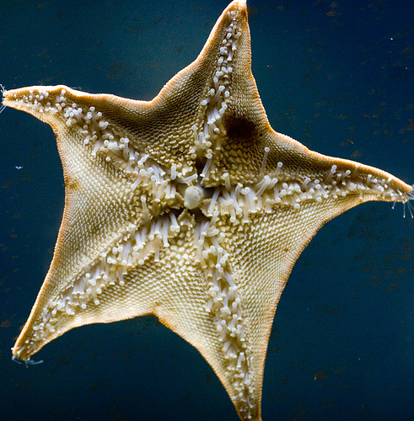
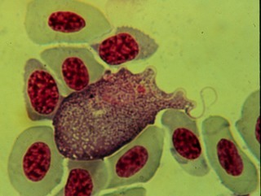
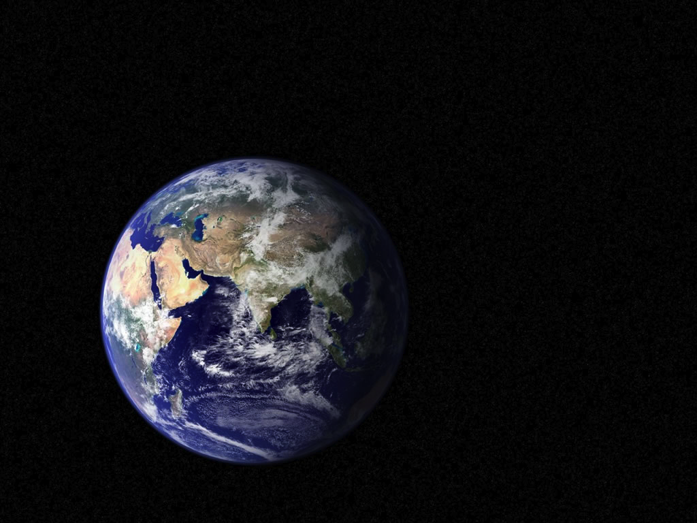
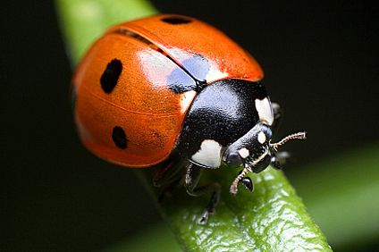
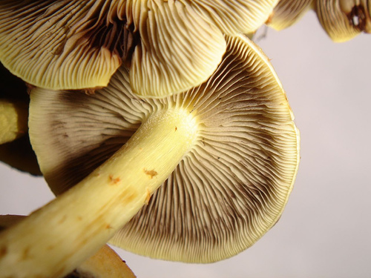
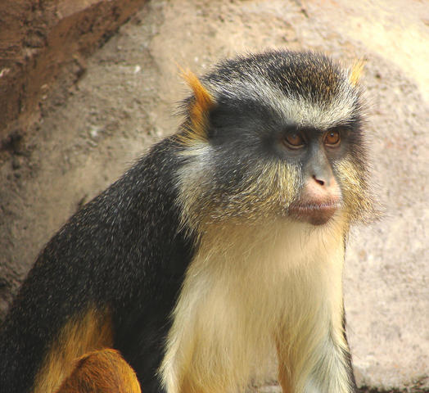
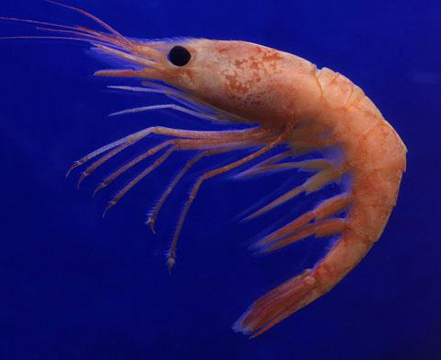
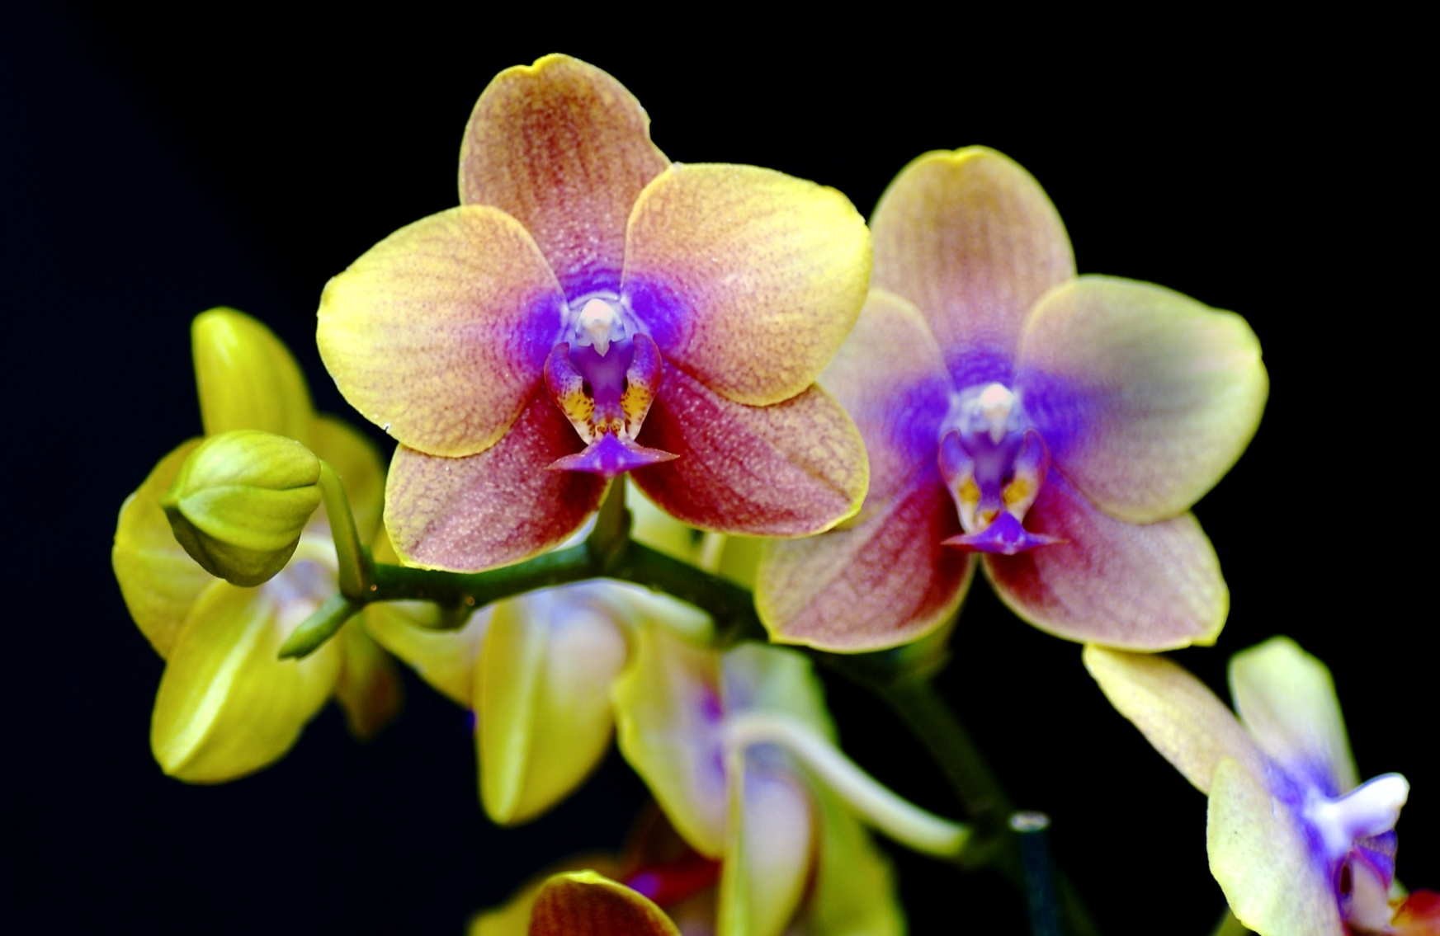
How do we benefit from biodiversity?
Notes:
But before we go any further, let’s talk about why we even care about biodiversity. What do we humans get from biodiversity?

Slide 7
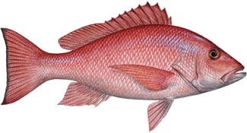
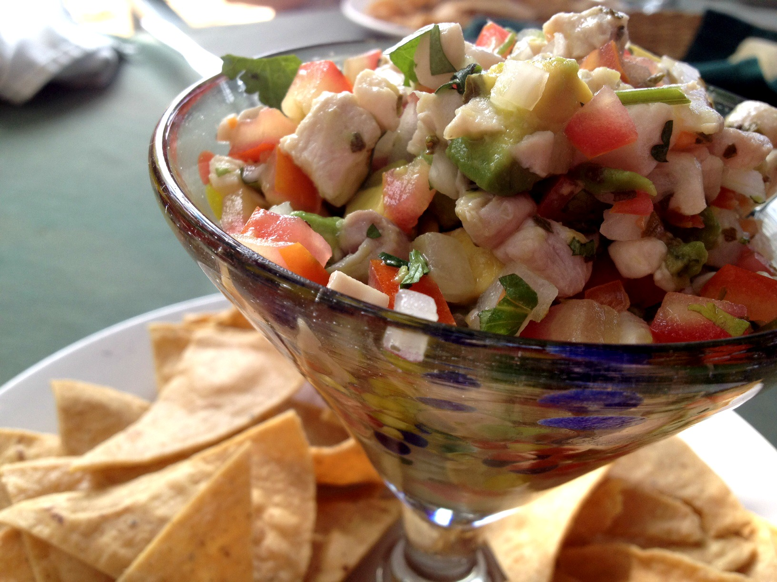
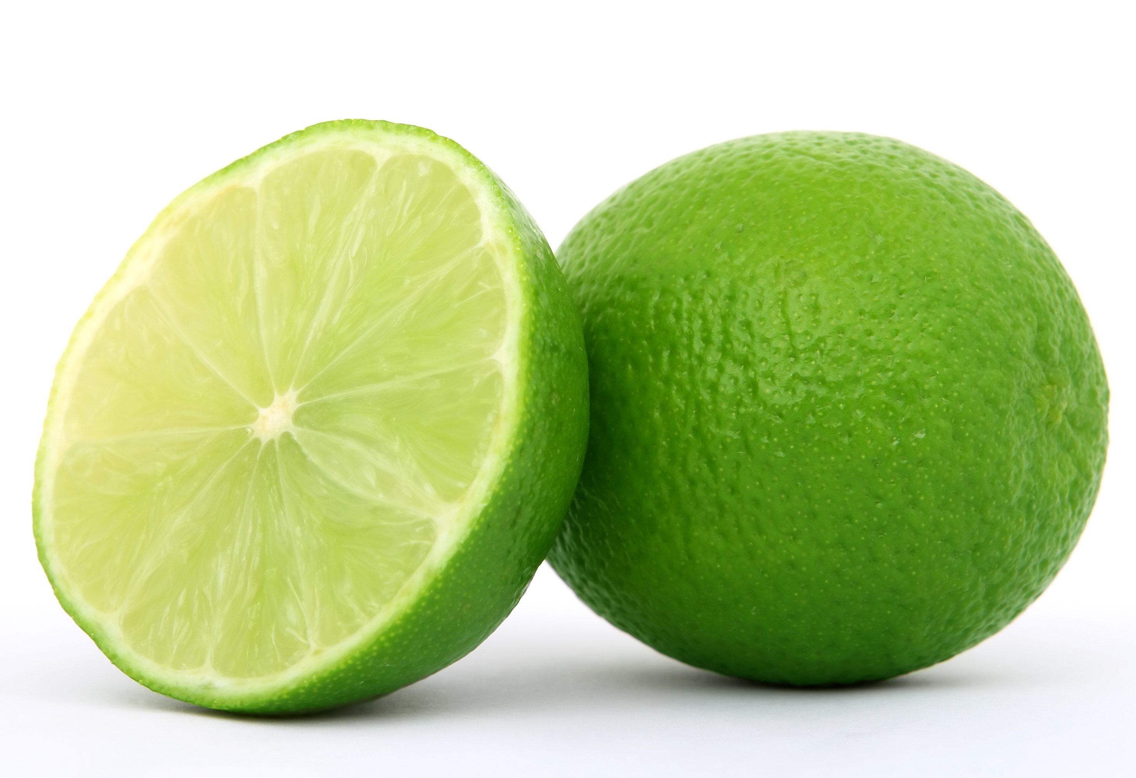
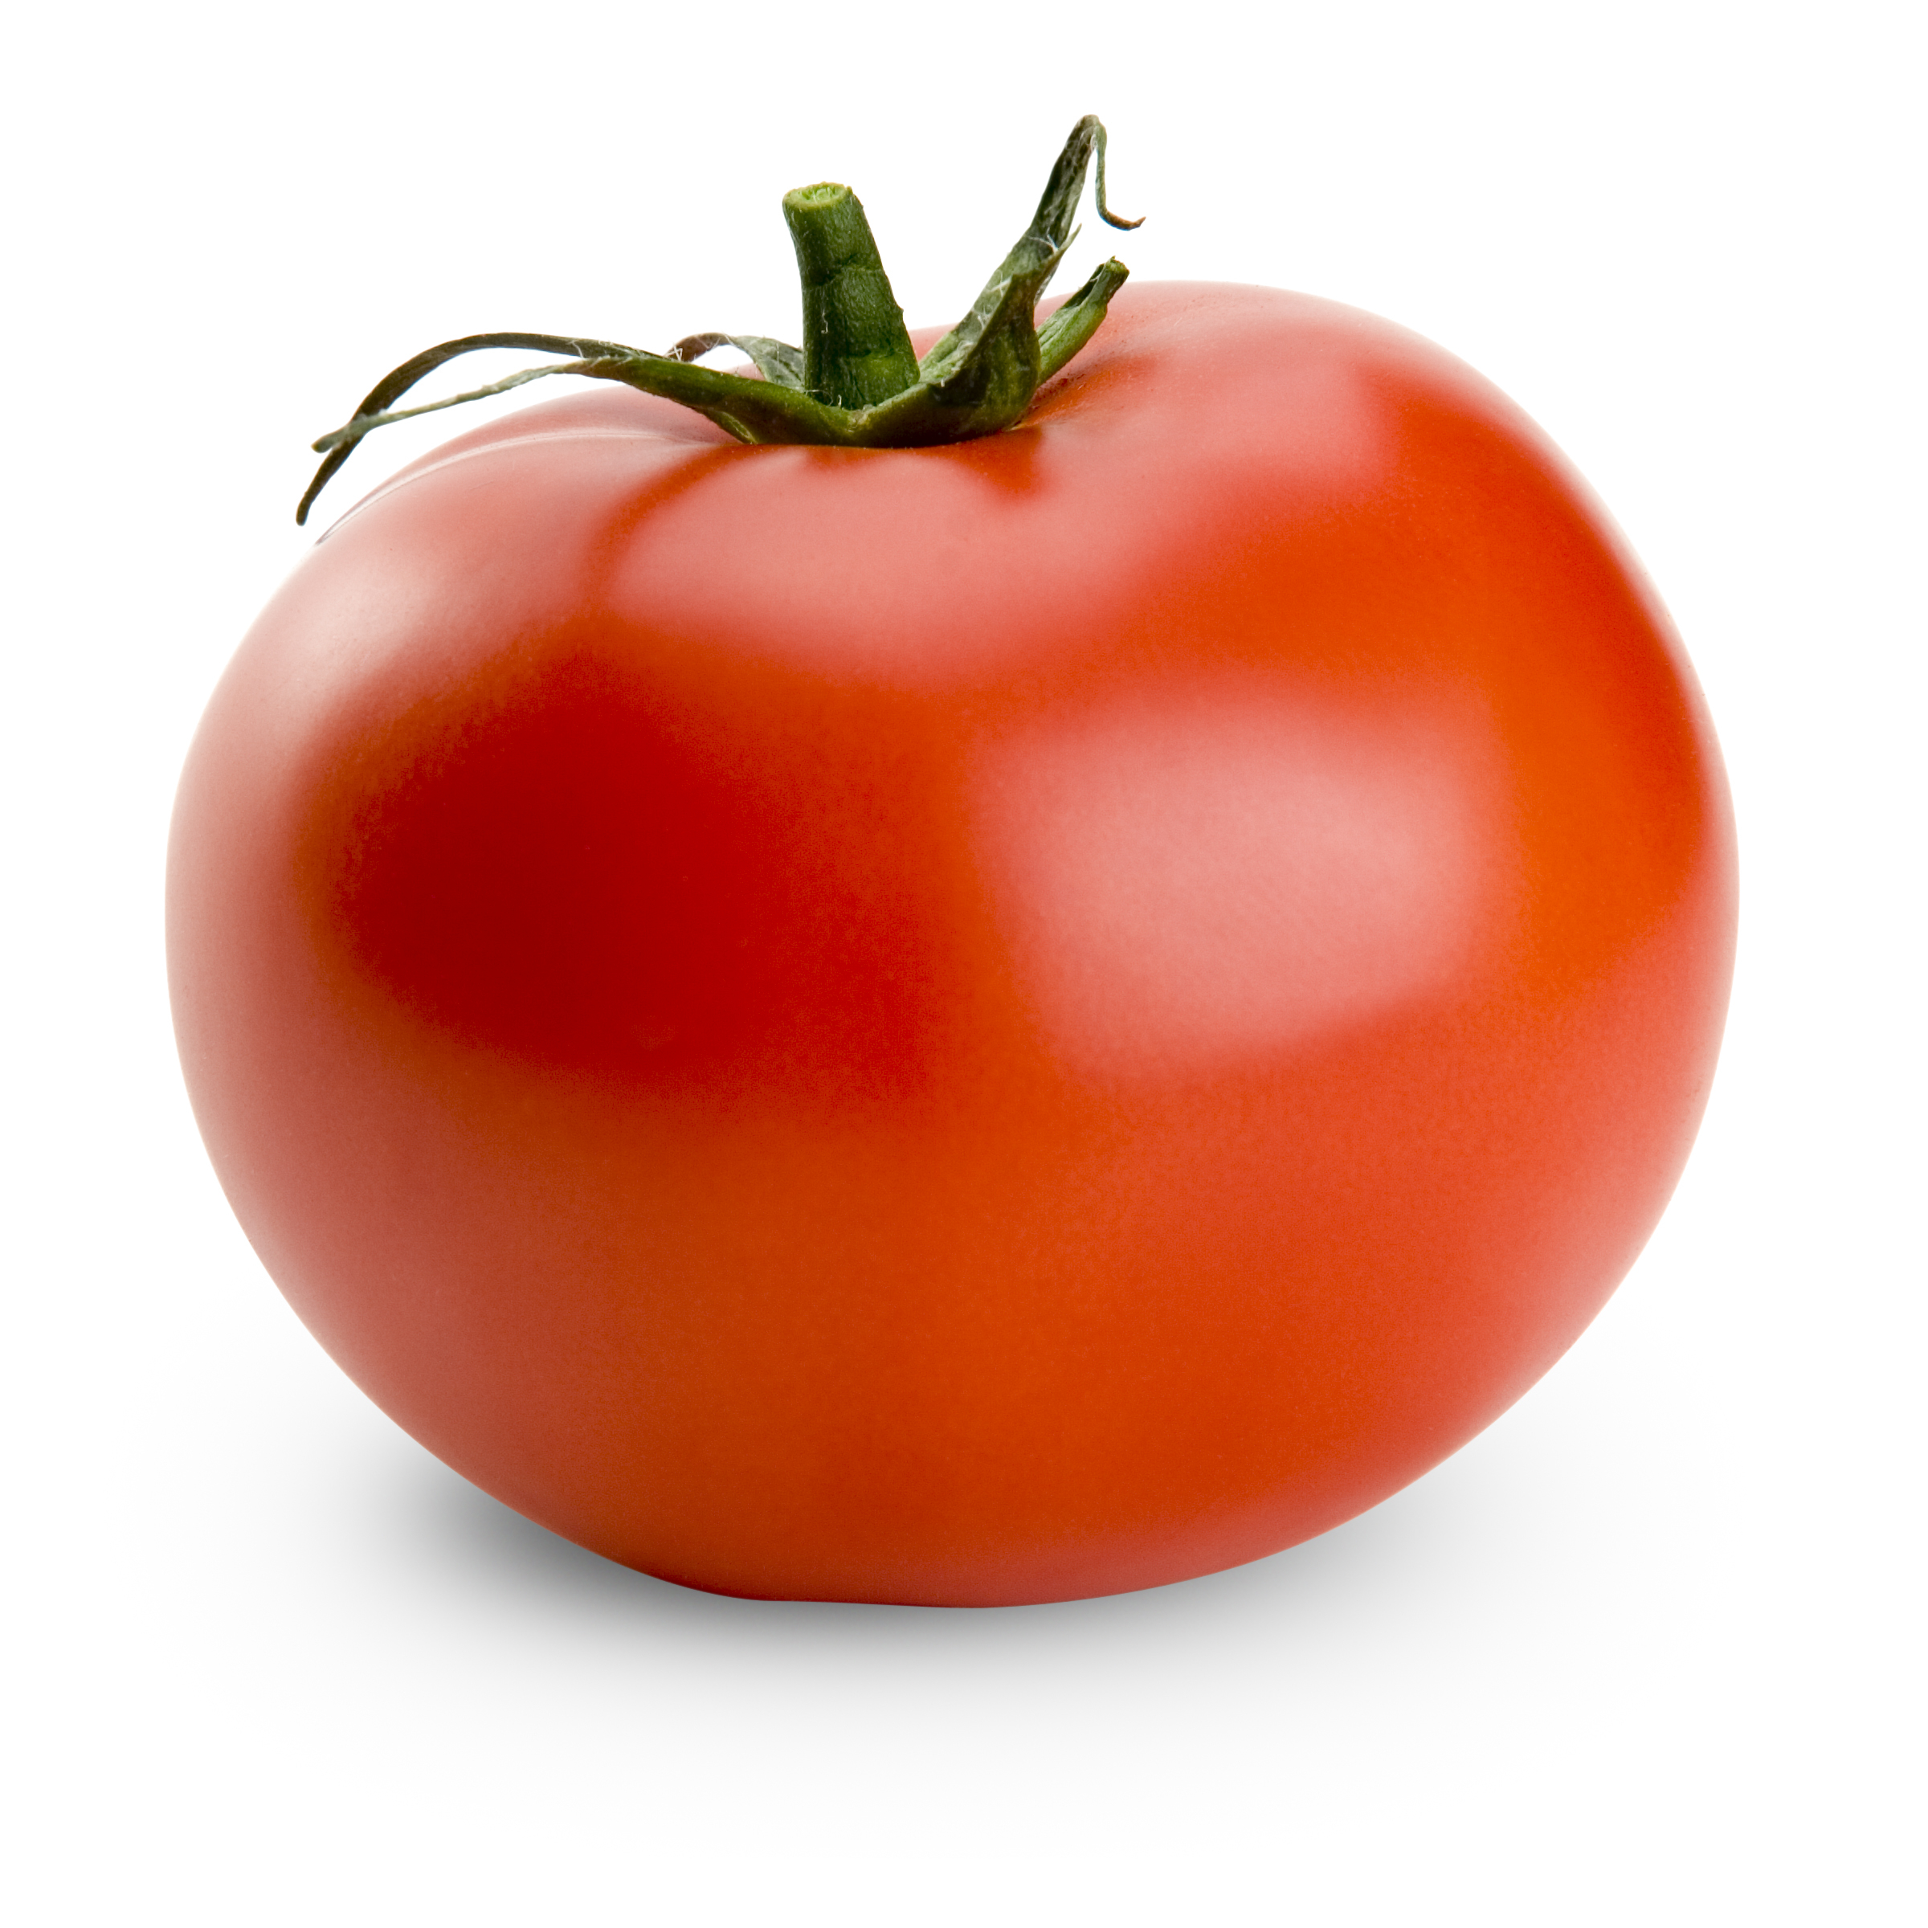
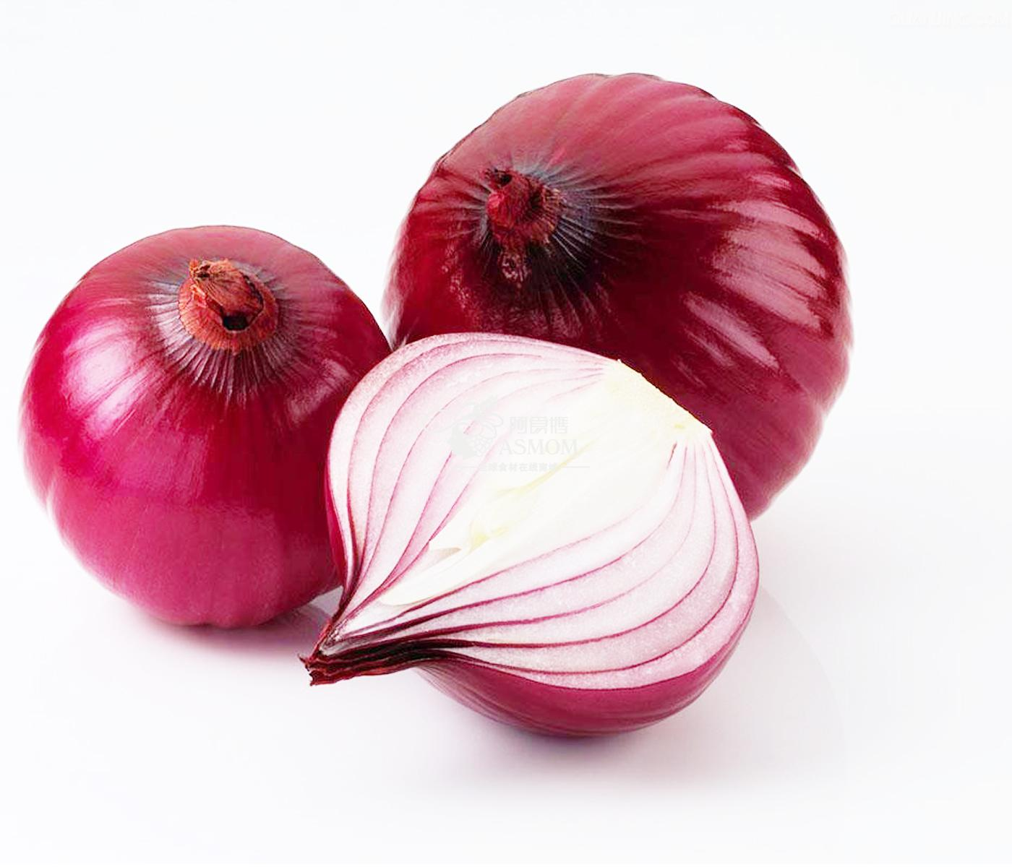
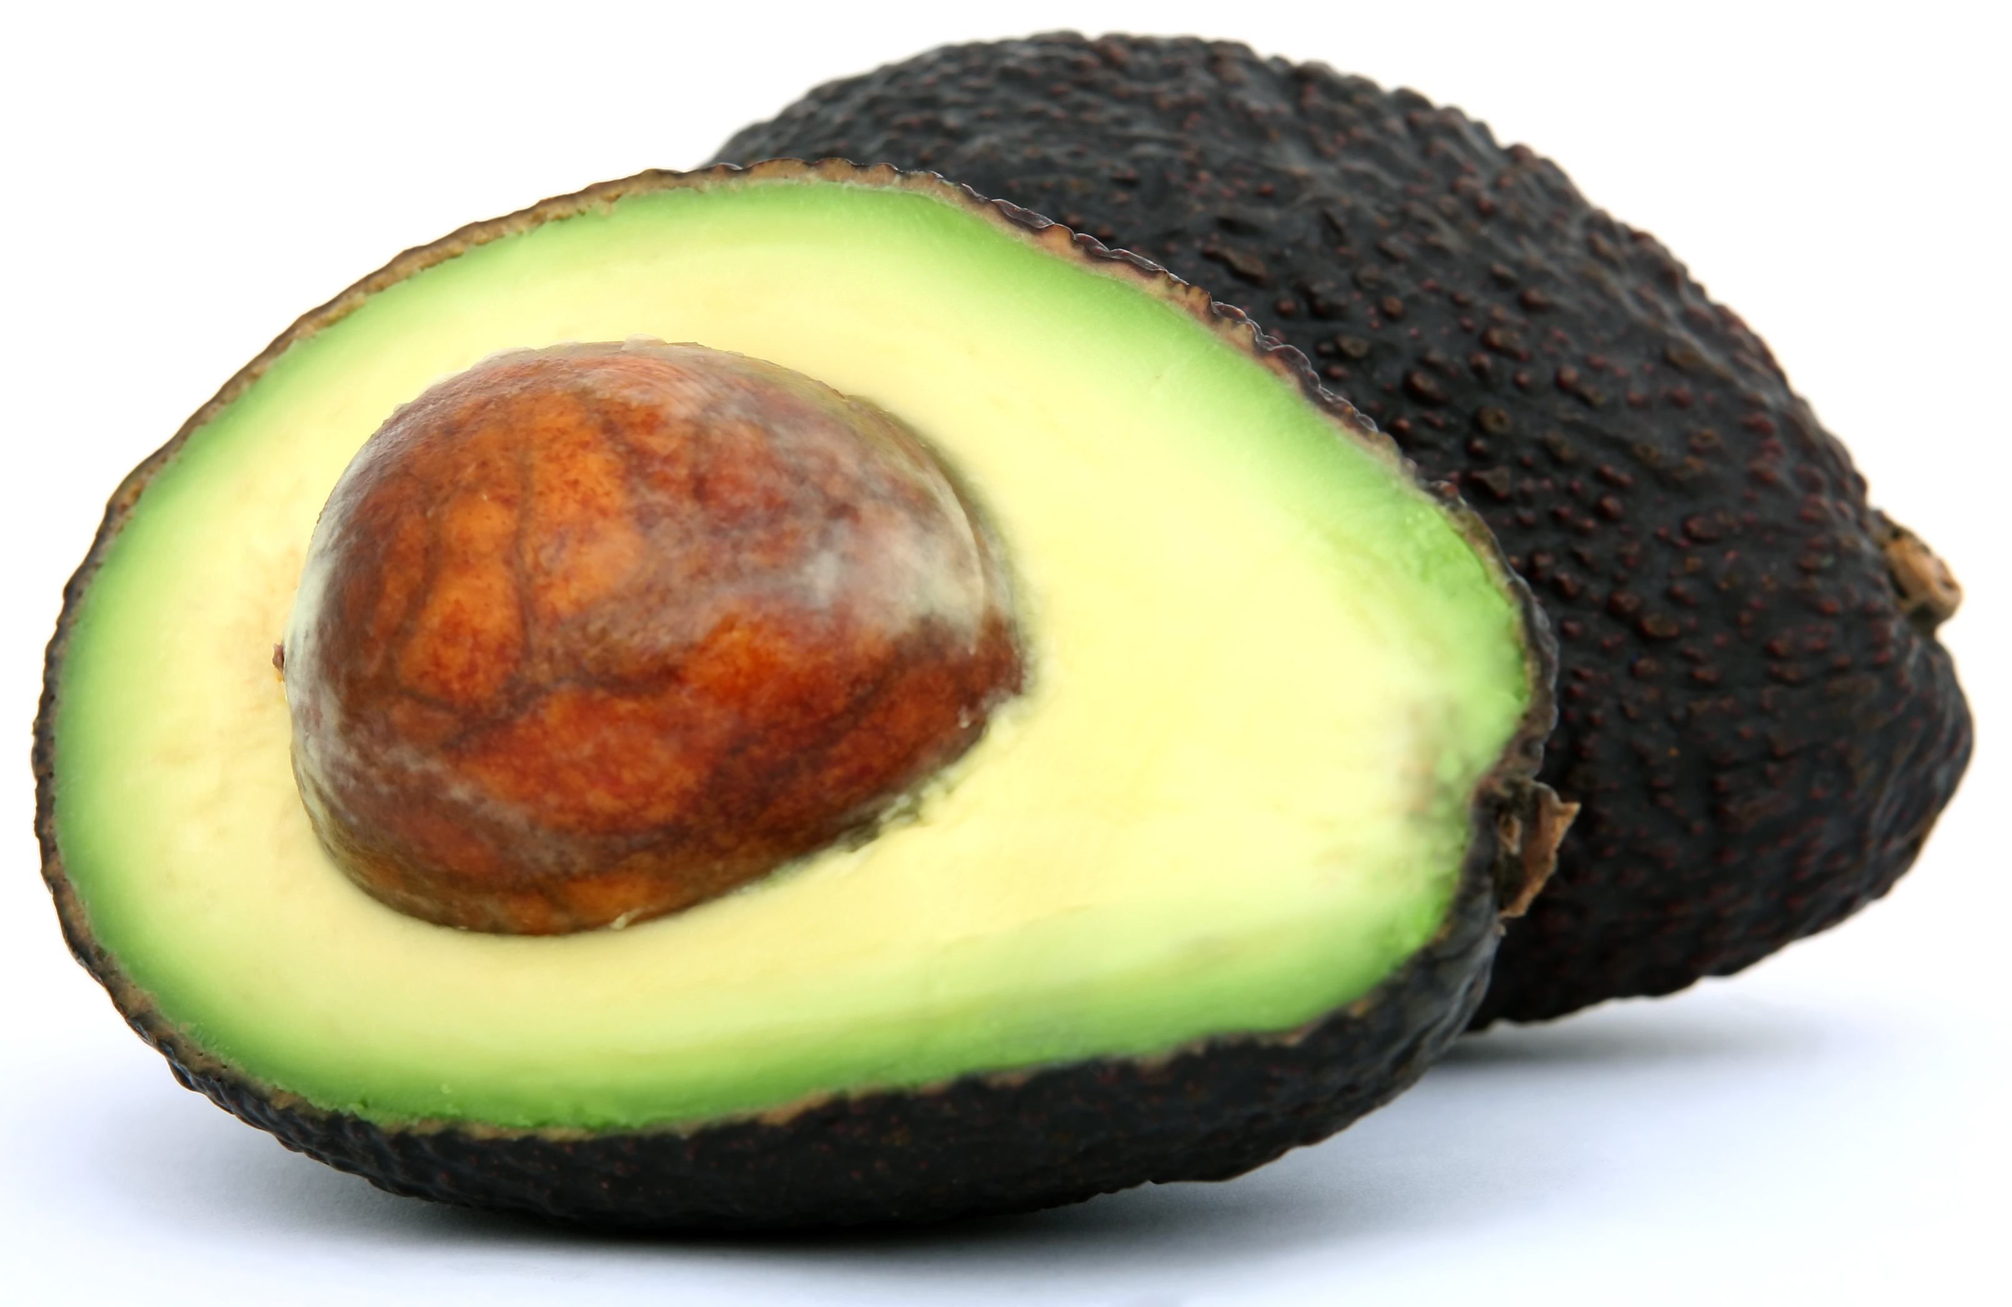
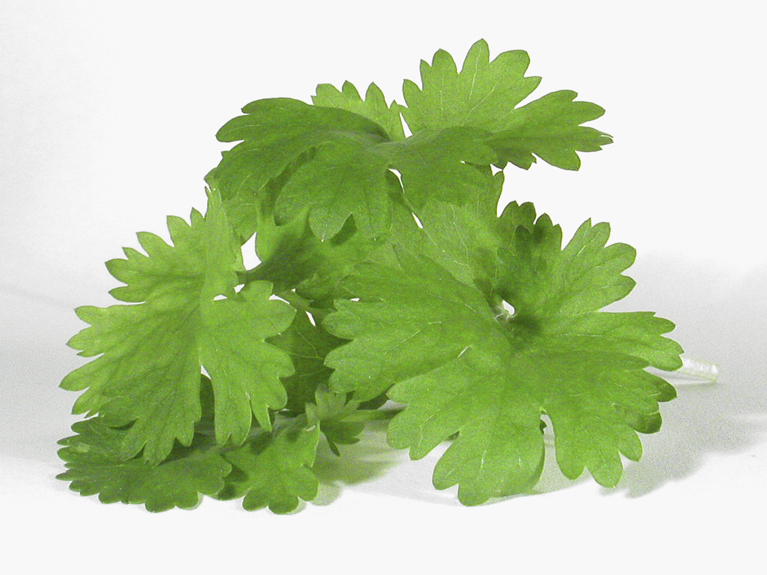
Food!
Notes:
Some twelve plant species provide approximately 75% of our total food supply, and only fifteen mammal and bird species make up more than 90% of global domestic livestock production.
What is not generally appreciated is that we depend on thousands of others species to produce these relatively few species.
Globally, 87 of the leading 115 food crops evaluated are dependent on animal pollinators, contributing 35% of global food production.
Even more numerous and diverse are the microbial species that live on, and in, plants and animals and that are especially abundant in soils. These serve, among other functions: to protect against pests, decompose wastes and recycle nutrients so that life can regenerate, convert atmospheric nitrogen to soil nitrogen compounds vital for plant growth, and live symbiotically in association with crop roots to facilitate the uptake of water and nutrients.

Slide 8
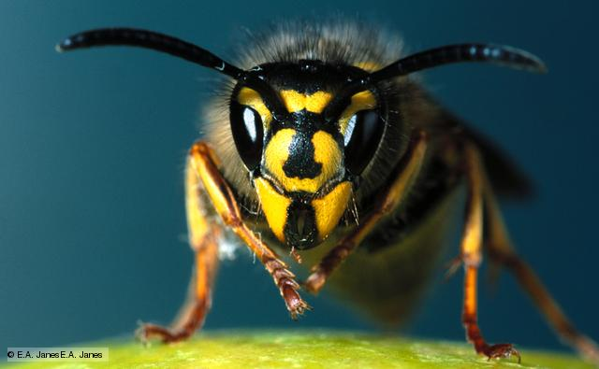
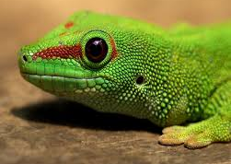
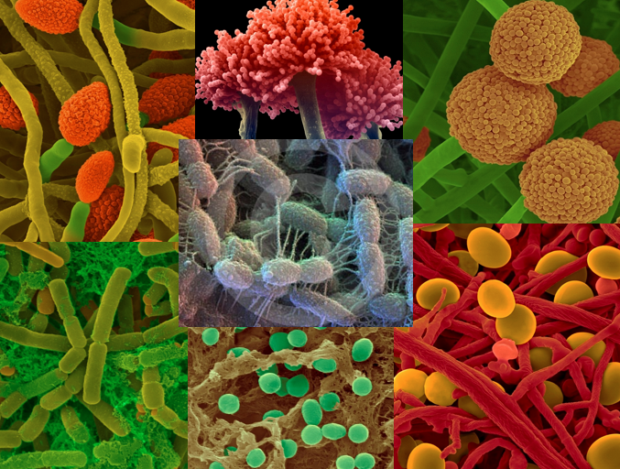
Our food supply depends on pollinators, and many other species!
Notes:
Pollinators, predators (functioning as biological control of pests), and microbes are all necessary to food production.

Slide 9
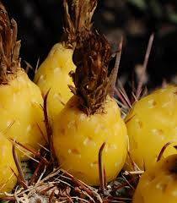
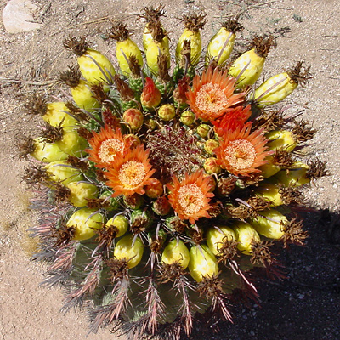
Pollinator Hotspots
Find a fishhook barrel cactus.
Pick one fruit.
Measure the height of the cactus.
Count the seeds and send in the seed count, the height, and the location of the cactus.
https://www.desertmuseum.org/center/hotspots/
© T. Beth Kinsey
Notes:
In addition to the schoolyard bioblitz, you can help museum scientists learn more about our Sonoran Desert bees by contributing to our Pollinator Hotspots program.

Slide 10
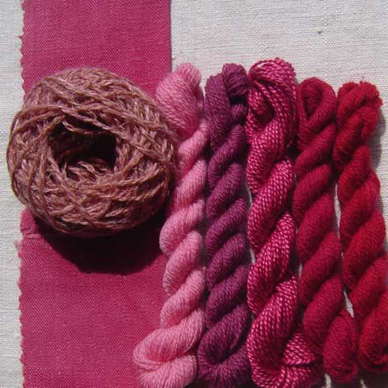
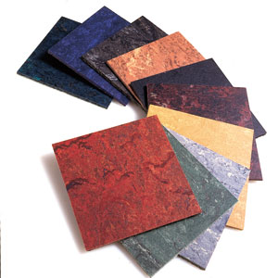
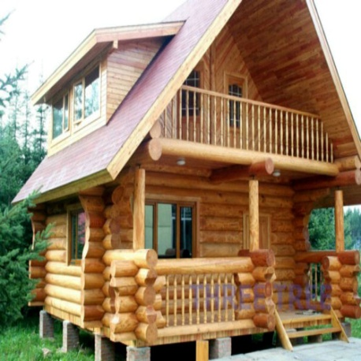
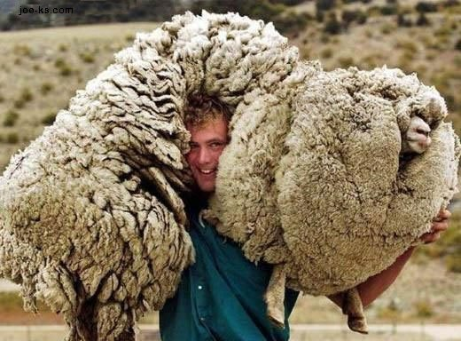


Materials!
Notes:
All sorts of materials are derived from biodiversity – cotton, wool, dyes, wood and paper products, cork, latex, etc.

Slide 11

Medicine!
25% of all pharmaceuticals in U.S. contain ingredients derived from native plants.
2,000 forest species found to have anti-cancer properties, thus far…

Slide 12
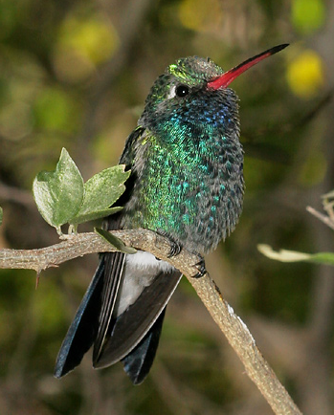
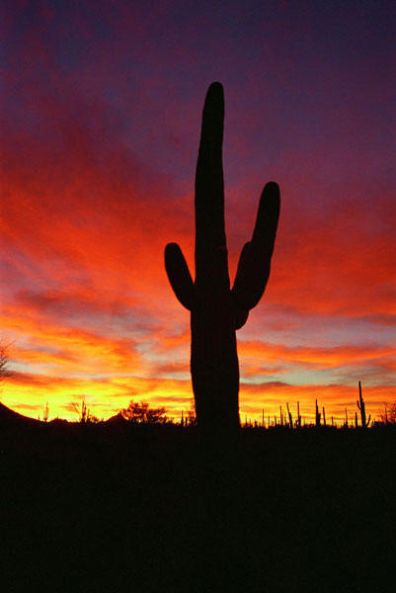
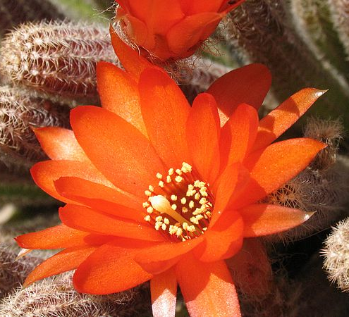
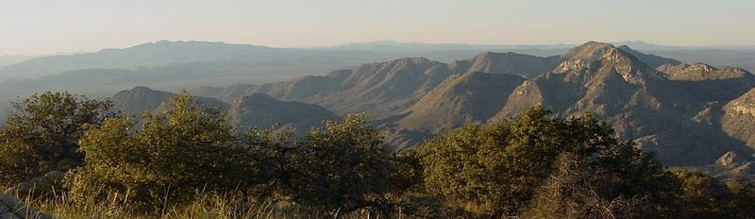
Biodiversity gives us our tourism industry.
Notes:
Without the tremendous diversity of species in our region, it wouldn’t be nearly as attractive to visitors. Our tourism industry, which is a major contributor to our economy depends on biodiversity.

Slide 13
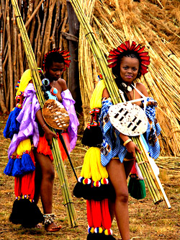
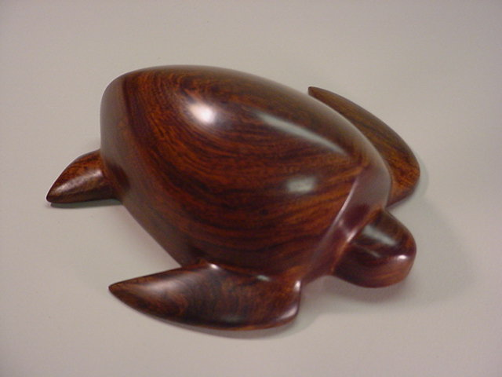
We derive cultural diversity from biodiversity
Notes:
People have adapted to the environments in which they live, and since those environments are all different from one another, cultural diversity stems in part from biodiversity. Left: ironwood carving by Seri people.

Slide 14
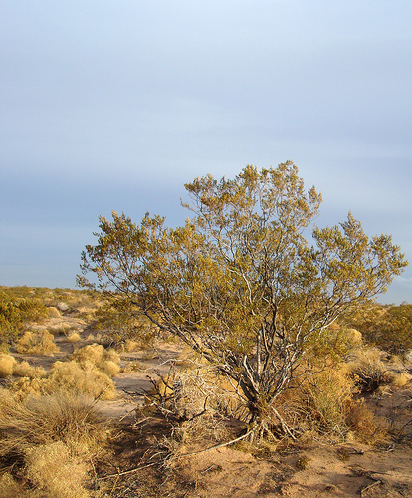
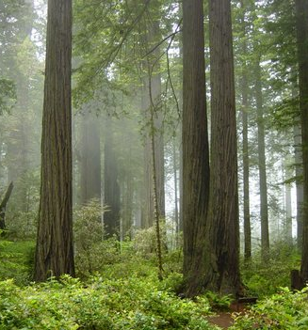
The Value of “Green” Space
Notes:
The researchers measured several indices of mental health. A key measure was an effect the researchers called reflection, which referred to the participants' reported ability to clear their heads, gain perspective on life and think more easily about personal matters.
One possible explanation comes from Stephen Kaplan's theory of restorative environments, which suggests that attention is the mediator between green space and psychological benefit. Kaplan hypothesizes that natural environments allow our directed attention to rest as nature engages an involuntary and effortless form of attention that he calls fascination; this in turn improves mood, directed attention, and cognition afterwards.
The economic impact green spaces have on home prices depends on how far the home is from the open space, the size of the open space and the characteristics of the surrounding neighborhood.

Slide 15
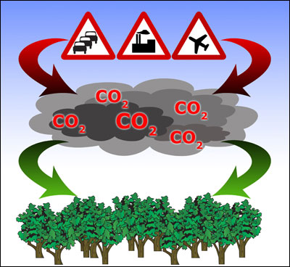

Biodiversity provides ecosystem services.
25 m² of tropical forest absorbs all the CO₂ released by one year of driving.
Ants increase the productivity of our farmlands.
Notes:
More diverse forests are more productive, i.e. they produce more green biomass annually. And in addition to producing biomass, they take up carbon dioxide and release oxygen. It’s a win-win!
Harnessing ecosystem services of naturally occurring organisms is an inexpensive but under-appreciated approach to increasing the productivity of our farmlands. Scientists have shown that ants and termites increase wheat yield by 36% over fields from which ants and termites were excluded. This increase in productivity is due to their tunnels allowing greater water infiltration and improved soil nitrogen from their building and waste products.
NYC example: New York City has one of the few sources of natural, unfiltered water in the U.S. It is the largest water system in the country operating under an approved filtration avoidance waiver. The abundant reserve of forest, as well as soil with adequate carbon levels, is essential to the Catskill/Delaware watershed’s excellent conditions for natural filtration. 1.3 billion gallons per day to 9 million people in New York City. $6-$8 billion for construction of new filtration facility
$200-$300 million operation and maintenance costs

Slide 16

We have identified 2 million species, but many millions more remain to be discovered.
Notes:
We have identified less than 10% of the species that live on Earth.

Slide 17
Archaea
Fungi
Protists
Bacteria
Plants
Animals
Notes:
Who make up the described species – clearly the focus has been on animals and plants. New molecular tools are making is possible to survey the lesser known groups.

Slide 18
30% of all named animal species are beetles!
67%

Slide 19



74% of all named animal species are insects!

Slide 20


86% (800,000) of all named animal species are arthropods!
Notes:
Arthropods are animals with an exoskeleton and jointed appendages. Insects are arthropods, but so are spiders and crabs.

Slide 21



Only 4% (60,000) of all named animal species are vertebrates!
Notes:
The point of the preceding series that the smaller animals, primarily insects, are going to be much more abundant in their schoolyards than the larger more charismatic reptiles, birds, and mammals.

Slide 22

How many Sonoran Desert species can you name in 30 seconds?

Slide 23
How many Sonoran Desert species can you name in 30 seconds?
Can you name an endangered species from the Sonoran Desert?
Notes:
Endangered Species: Acuna cactus, Nichol’s Turks Head Cactus, Jaguar, Ocelot, Mexican Gray Wolf, Masked Bobwhite, Bald Eagle, Chiricahua Leopard Frog, Desert Pup Fish, Huachuca Water Umbel, Kearney’s Bluestar, etc. (23 total in Pima County)

Slide 24

History of Biodiversity
Notes:
The number of species living on our planet is constantly fluctuating as new species evolve and others go extinct. But our planet has seen five periods during which extinction rates went up dramatically. These events in earth’s history are know as mass extinction events.

Slide 25

The most recent mass extinction event eliminated the dinosaurs.
Notes:
The most recent mass extinction occurred about 60 million years ago, and was the one that eliminated the dinosaurs. It was at least partially the result of a meteor that collided with Earth, causing a tremendous cloud of dust to blanket the Earth.

Slide 26
The Sixth Mass Extinction
Notes:
We are in the sixth mass extinction on the planet, and species are being lost at a faster pace than seen in any of the five previous mass extinctions.
March 2012 – World population reaches 7 billion. The world didn't reach 1 billion inhabitants until 1800, according to the Population Reference Bureau, and it reached 2 billion in 1930. But with advances in modern medicine, it took only 30 more years to reach 3 billion, 14 years to reach 4 billion, 13 years to reach 5 billion and 12 years to reach both 6 billion and 7 billion.
When you are between 31 and 32 years old, you will have lived for 1 billion seconds. To reach 7 billion seconds, you would have to live to be 220 years old!
If you stacked up 7 billion sheets of copy paper, the stack would be 504 miles high — about the distance to the international space station and back again!

Slide 27

Human Population Growth
Population reaches 7 billion
Population reaches 1 billion
"World-Population-1800-2100" by Tga.D based on Aetheling's work - based on file:World-Population-1800-2100.png, but converted to SVG using original data from U.N. 2010 projections and US Census Bureau historical estimates. Licensed under CC BY-SA 3.0 via Wikimedia Commons - https://commons.wikimedia.org/wiki/File:World-Population-1800-2100.svg#/media/File:World-Population-1800-2100.svg
Notes:
We are in the sixth mass extinction on the planet, and species are being lost at a faster pace than seen in any of the five previous mass extinctions.
March 2012 – World population reaches 7 billion. The world didn't reach 1 billion inhabitants until 1800, according to the Population Reference Bureau, and it reached 2 billion in 1930. But with advances in modern medicine, it took only 30 more years to reach 3 billion, 14 years to reach 4 billion, 13 years to reach 5 billion and 12 years to reach both 6 billion and 7 billion.
When you are between 31 and 32 years old, you will have lived for 1 billion seconds. To reach 7 billion seconds, you would have to live to be 220 years old!
If you stacked up 7 billion sheets of copy paper, the stack would be 504 miles high — about the distance to the international space station and back again!

Slide 28




Notes:
Virtually all modern day terrestrial species extinctions result from human activities that lead to habitat loss/degradation and invasive species (especially on islands, eg. Hawaii).
Upper left: Dead cottonwood tree - loss of riparian habitat.
Lower right: But an even more important source of habitat loss is agriculture, an example shown here of a Arizona cotton field. About 50% of useable terrestrial land is devoted to agriculture, which includes grazing livestock and growing crops (Tilman et al. 2001).
Buffelgrass in the Catalinas: An invasive species is a species that does not naturally occur in a specific area and whose introduction does or is likely to cause economic or environmental harm.

Slide 29





What’s a Bioblitz?
Notes:
Bioblitz: an effort to record as many different species as possible in a given area over a short period of time.

Slide 30
What’s a Bioblitz?
An attempt to record as many species as possible in a defined area in a short amount of time.

Slide 31

Saguaro National Park Bioblitz 2011
BioBlitz teams found at least 859 different species in 24 hours, including more than 400 species new to the park.

Slide 32

Urban Biodiversity
Cities are often located in places with lots of biodiversity.
Biodiversity in our cities provides us with many benefits.
Scientists are working to understand how we can foster biodiversity in our cities.
Notes:
Benefits of urban biodiversity – pest control (birds of prey that feed upon pigeons, other birds and rodents); clean air and water; healthy soil; prevention of erosion and flooding; pollination;

Slide 33

Schoolyard Biodiversity
Notes:
Benefits of urban biodiversity – pest control (birds of prey that feed upon pigeons, other birds and rodents); clean air and water; healthy soil; prevention of erosion and flooding; pollination;

Slide 34
Calculating Biodiversity
Species Richness - The most useful and straightforward measure of biodiversity is simply a species count.
Species Diversity – Diversity takes into account evenness, or how individuals are distributed among species.

Slide 35
Species Diversity
Richness – number of species in a given area
Evenness – distribution of individuals among species
B
A
C
A
A
A
B
C
A
A
B
A
A
C
A
A
B
B
B
A
C
A
A
C

Slide 36

Species Accumulation Curve
Measure of the completeness of your survey

Slide 37

Thank You!
Kim Franklin, Ph.D.
Conservation Research Scientist
Arizona-Sonora Desert Museum
Notes:
Feel free to modify this presentation however you might like!

