Slide 1
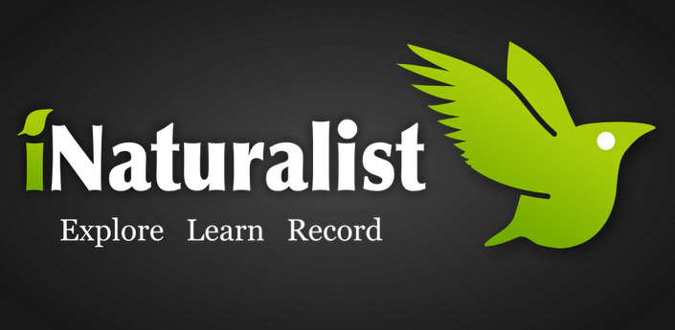
How to participate in Citizen Science using iNaturalist
by Julie Byrne-Wittmann
Email: protecthabitat@gmail.com
Website: www.protecthabitat.com

Slide 2
Getting Started with iNaturalist
Explore the iNaturalist.org site
Set-up your iNaturalist account
Join our project
If you have a Smart Phone (iPhone or Android), download the free iNaturalist application
www.inaturalist.org
Notes:
iNaturalist At A Glance
Your Profile
Observations- list all of the observations you have made, the time you observed the species and location of species occurrence.
Species list- You can view the species you have observed (your ‘Life List’) as a plain list, taxonomic list, or photo list.
Journal- The ‘Journal’ allows you to create new entries and save them to your profile. You can journal about projects you are working on, locations of observations, or anything else related.
Follower- Allows you to follow your friends, affiliates and colleagues to see what they are observing and posting on their profile (work in the same fashion as ‘friending’ on Facebook, however you do not send requests).
Pepperwood Monitoring Project
Observations- You can scroll through the collective list of observations (‘Table View’) or you can go to ‘Observations>View Map’. In the map view window, you can view all the locations where observations have been made at Pepperwood Preserve.
Other features on the project page- you can view members, review data in KML, CSV, or checklist format.
* The iNaturalist help page (http://inaturalist.org/help#observations1) is quit thorough and comprehensive. If your using iNat online and are confused about a utility, this is a great place to reference.

Slide 3
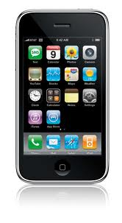
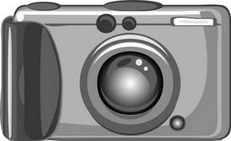
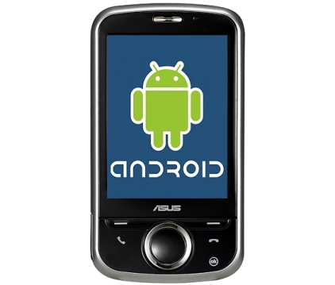
OR
Android Phone
Digital Camera + GPS
iPhone
Notes:
iNaturalist Observation Protocol
Equipment to record an observation on iNaturalist
iPhone
GPS + digital camera
Tools for Making Species Observations
Notebook
Hand lense
Binoculars
Species Field Guides
Pepperwood Preserve maps
Compass
Good pair of hiking boots!

Slide 4
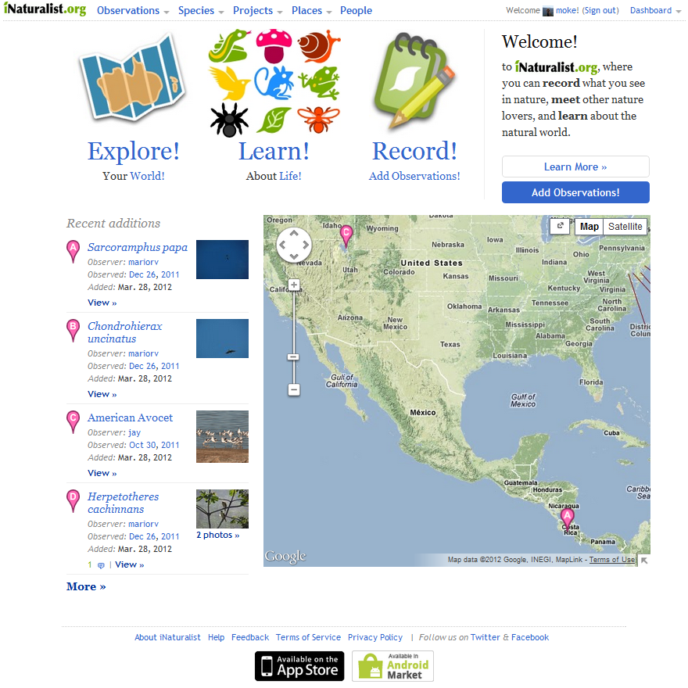
A social network launched in 2011 for naturalists to store, share and map photographic species observations
Notes:
What is iNaturalist?
iNaturalist.org is an online community forum for people interested in the natural world. It serves three purposes:
Provides software tools for recording information about nature.
Shares information about nature and other sources of natural history information.
Target users- facilitates communication between naturalists, (citizen) scientists, students and educators.
How does iNaturalist work?
At its core, iNat is a social-network much like Facebook or Twitter; through which participants create user profiles and share information. Species
and ‘places’ (countries, states, protected areas, etc.) can also be featured on profile pages. Through the iNat iPhone app or on the website,
participants submit observations that record the locations and dates of sightings along with optional photos and identifications. By exchanging
comments on observations, expert participants can provide feedback on species identifications, associated photos, and the location or timing of
sightings. Each confirmed observation is linked to a species page that summarizes biological attributes and global distribution. Participants can
automatically link to external resources such as the Encyclopedia of Life and Wikipedia. Place pages show the boundaries of the place, recent
observations, and a checklist of species that are expected to occur in the place.
What you can do with iNaturalist?
The observer (the ‘iNatter) can log what, where, and when of a sighting/observation, thus creating a personal history of such findings, communicating these findings with other users, as well as uploading digital photos. Specifically, iNaturalist-
Indentifies the organism.
Records the time of the observation.
Tracks the location of the observation (within a Google Map interface- decimal degrees).

Slide 5
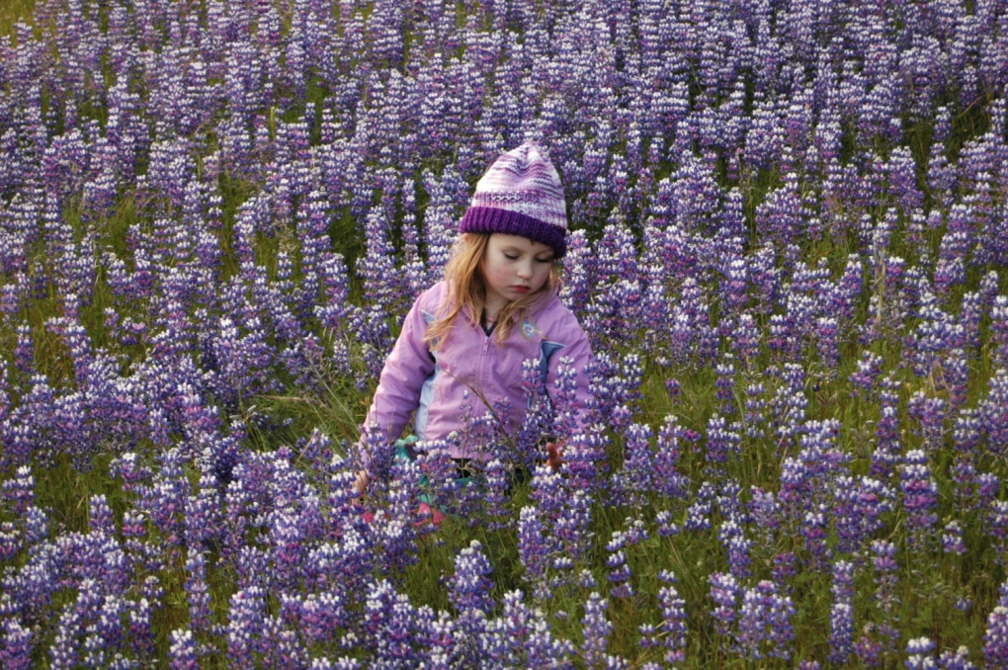
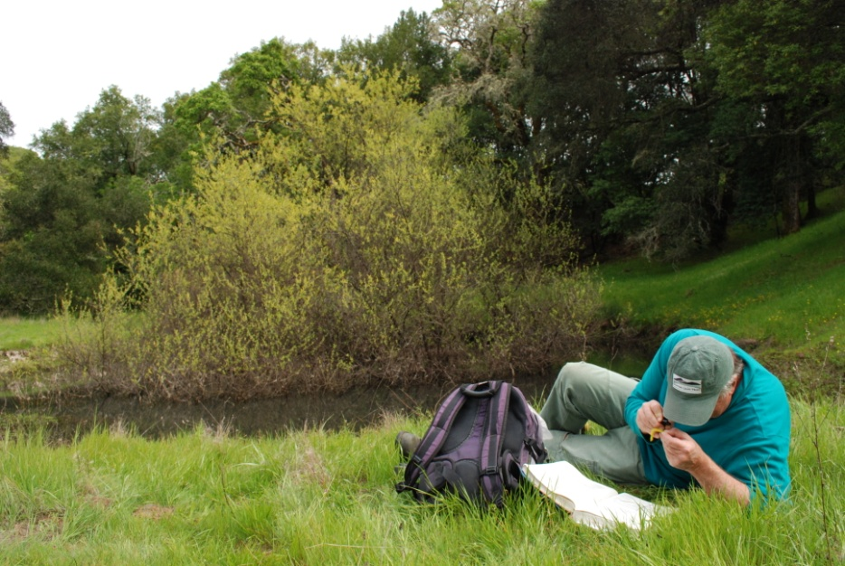
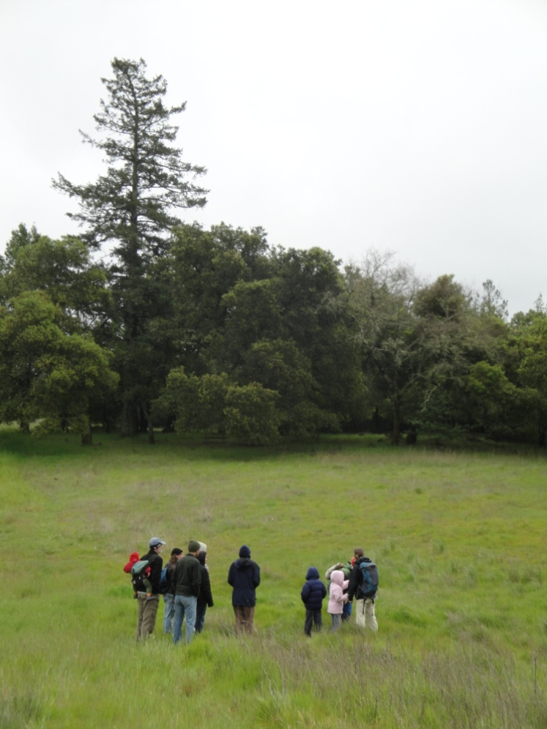
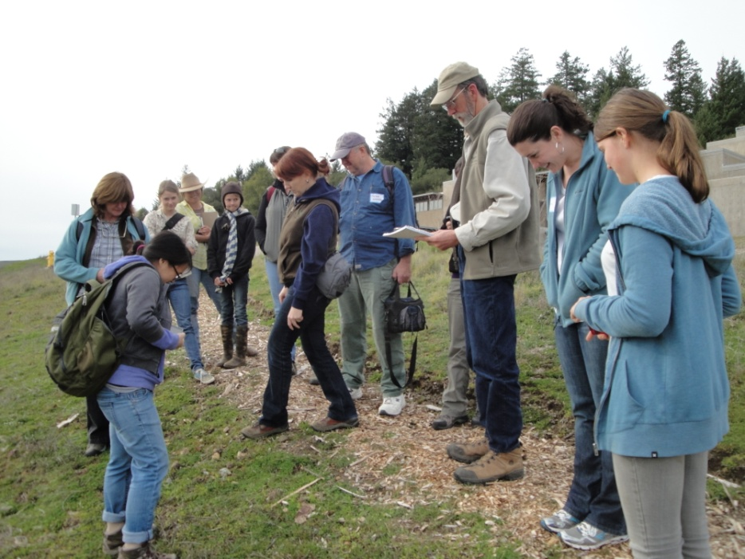
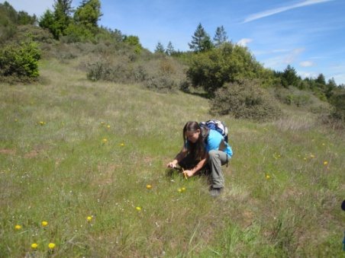
Who can Use iNaturalist.org?
scientists, land managers, regional experts
students & children
educators
stewards, interns, volunteers
naturalists & nature enthusiasts
Collecting the information we need to influence conservation and habitat goals, while immersing volunteers, students, and nature enthusiasts into the scientific process
Notes:
Who can Use iNaturalist.org?

Slide 6
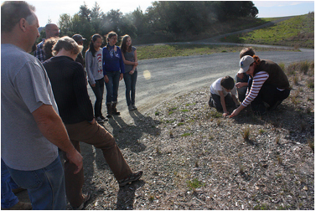
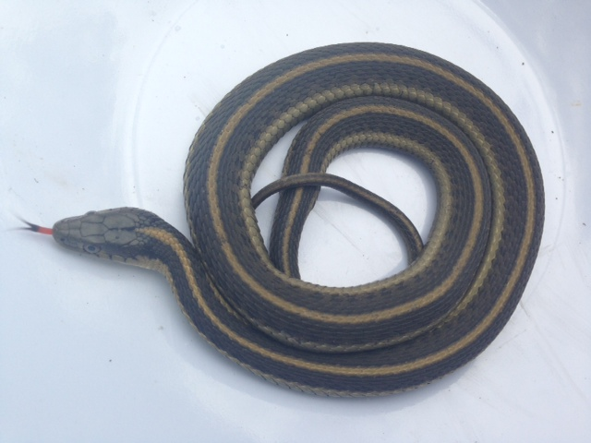
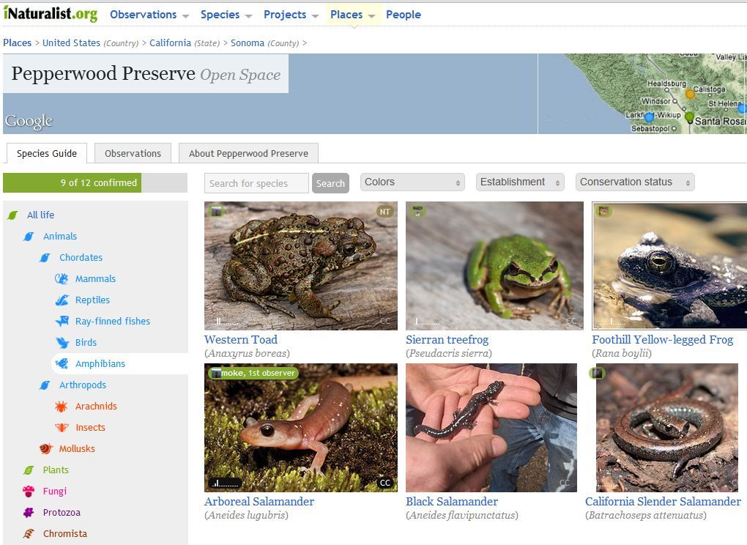
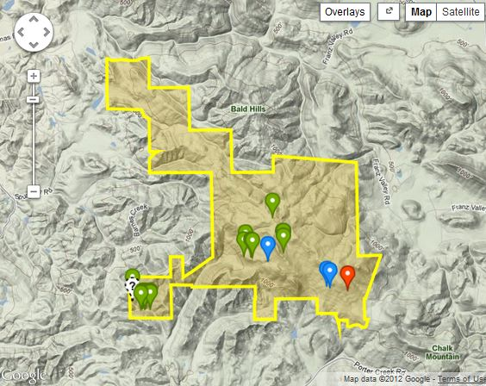
How Does iNaturalist Work?
WHO
WHAT
WHEN
Julie Byrne-Wittmann
HOW
WHERE

Slide 7
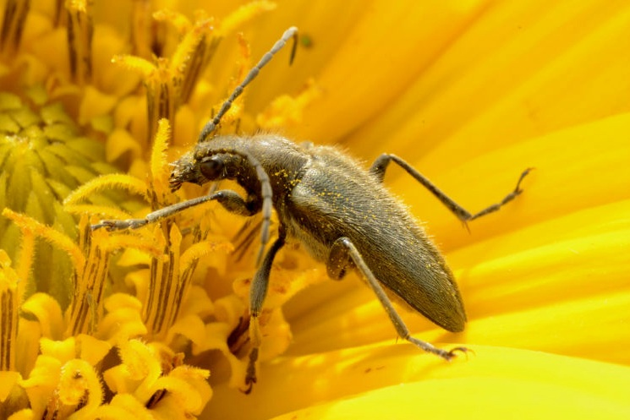
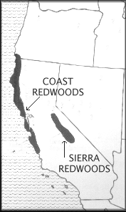
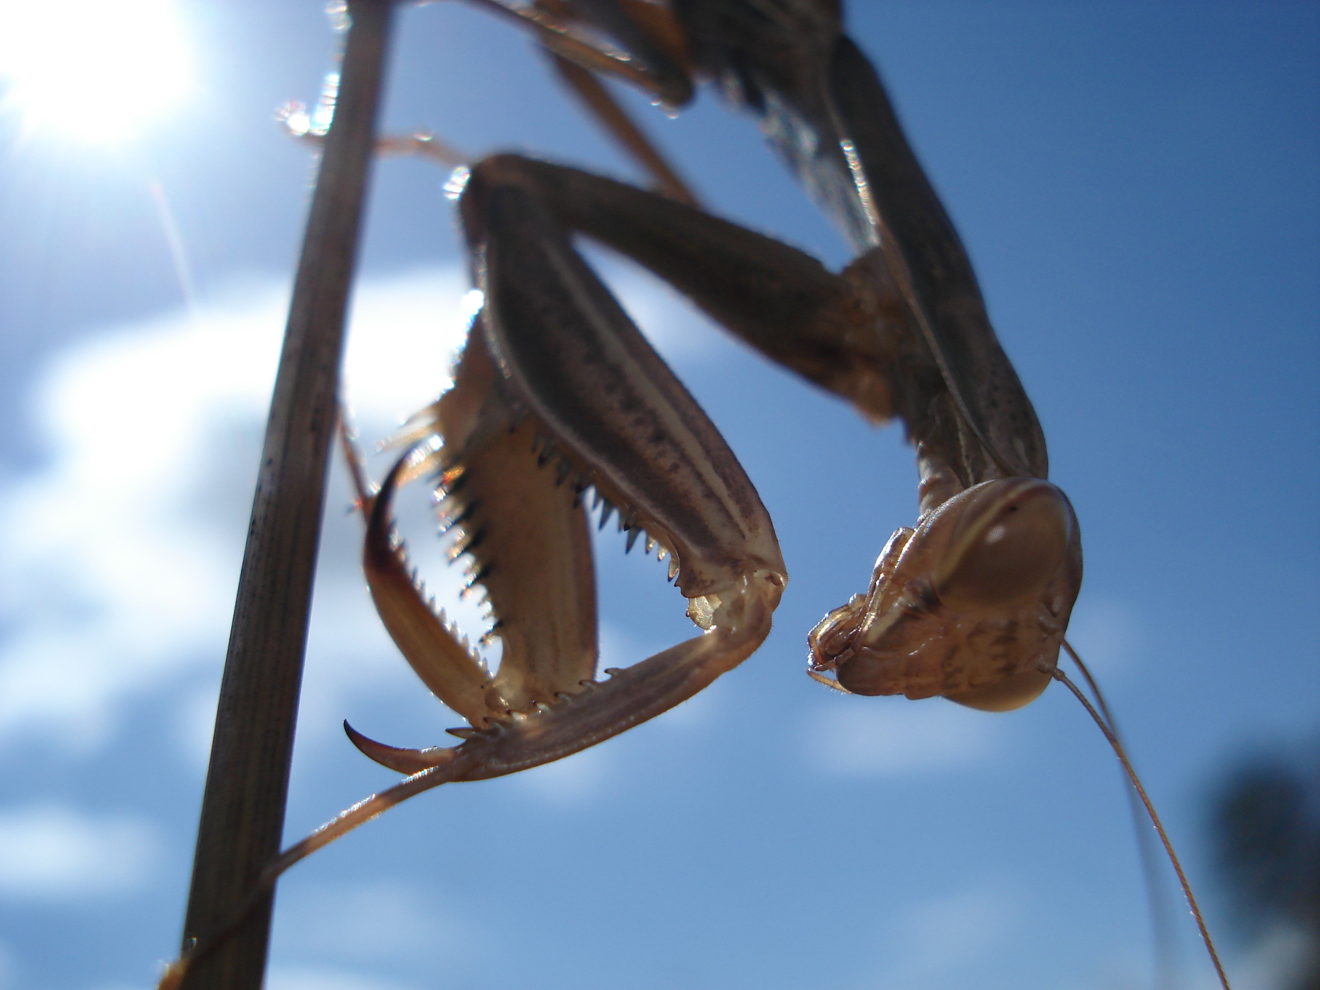
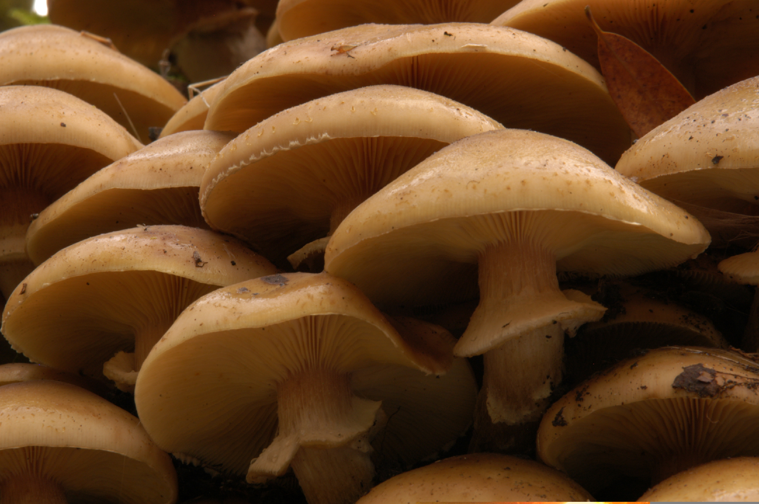
Why Are Species Observations Important?
New Species & Their Locations
Species Distributions
Help Scientists
Preserving Nature
©CA.Gov
Photos courtesy of Greg Damron

Slide 8
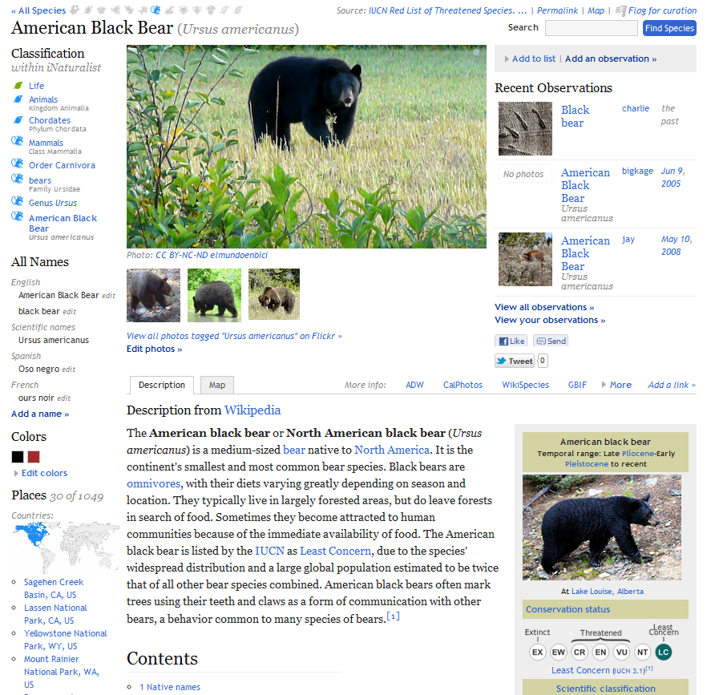
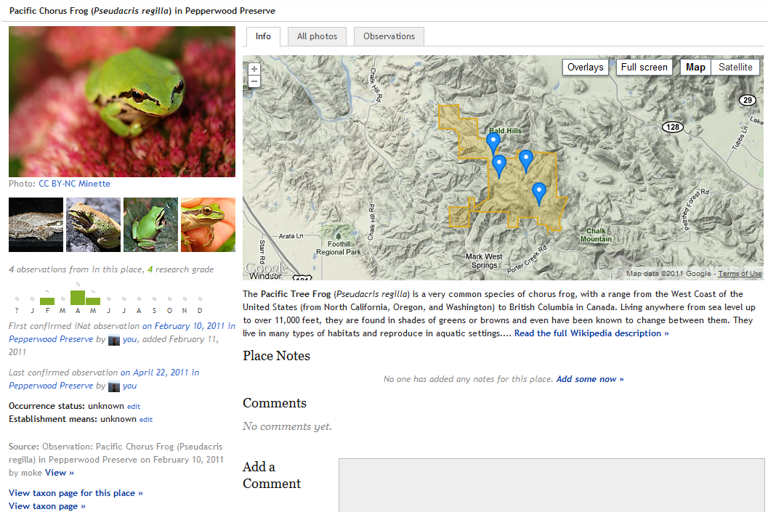
iNaturalist.org Features at a Glance
Add a species observation
Tools for identifying & verifying species
Search for species by region or land parcel
Species classification & description resources
View species distribution ranges

Slide 9
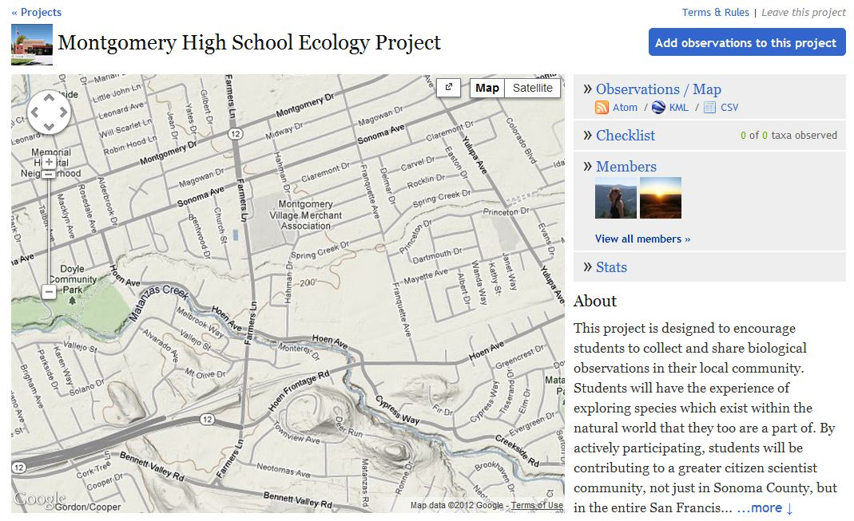
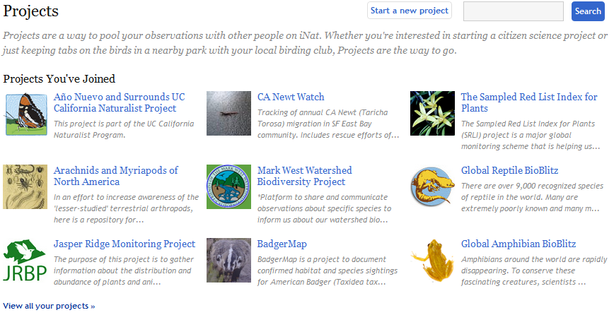
iNaturalist.org Features at a Glance
Add your observations to a project

Slide 10
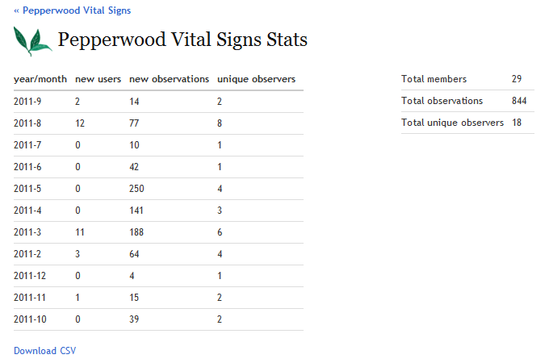
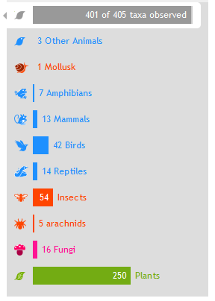
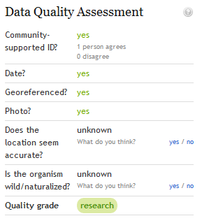
iNaturalist.org Features at a Glance
Helps Determine Red List of Threatened Species
Track observations & manage data
Answer scientific questions
Enrich Bay Area biodiversity data

Slide 11
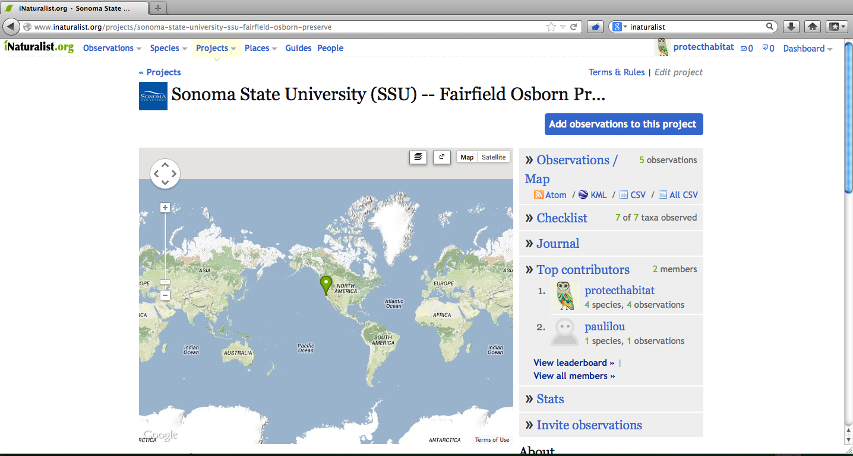
Sonoma State University (SSU)
Fairfield Osborn Preserve’s Project
www.iNaturalist.org

Slide 12
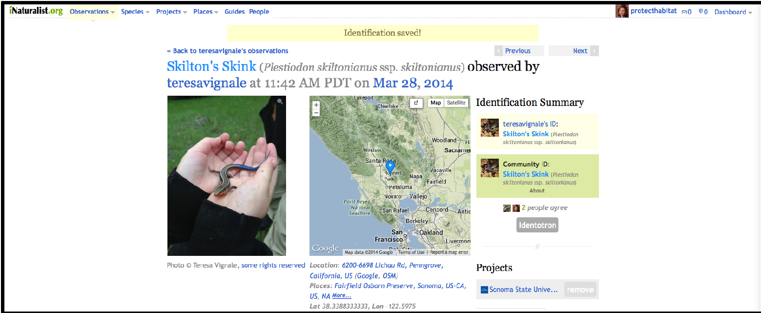
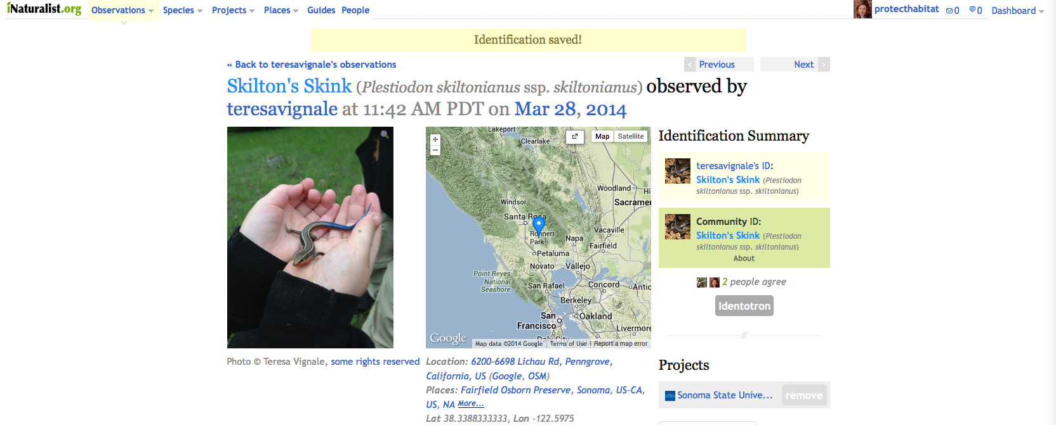
Notes:
Which looks like this

Slide 13
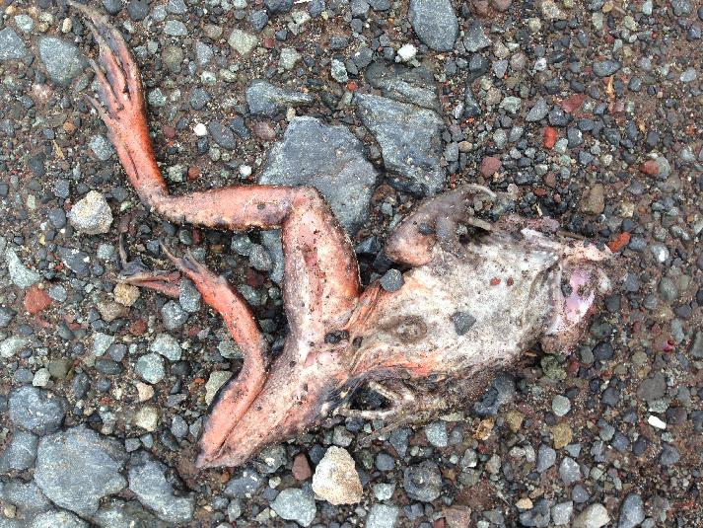
Julie Byrne-Wittmann

Slide 14
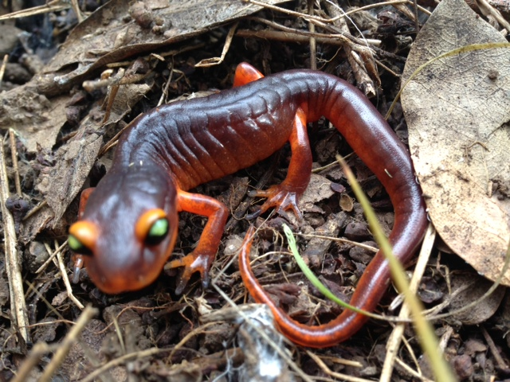
YEEN
Julie Byrne-Wittmann

Slide 15
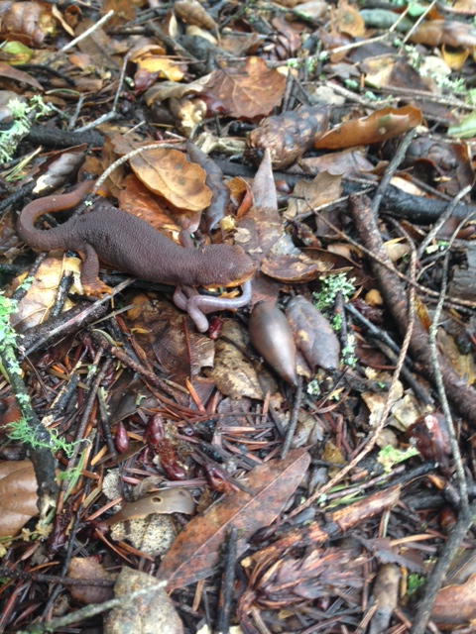
Julie Byrne-Wittmann
Julie Byrne

Slide 16
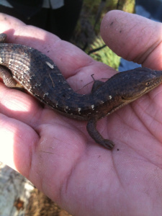
Julie Byrne-Wittmann

Slide 17
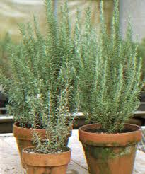
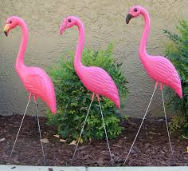
Species Observations DO NOT Include . . .

Slide 18
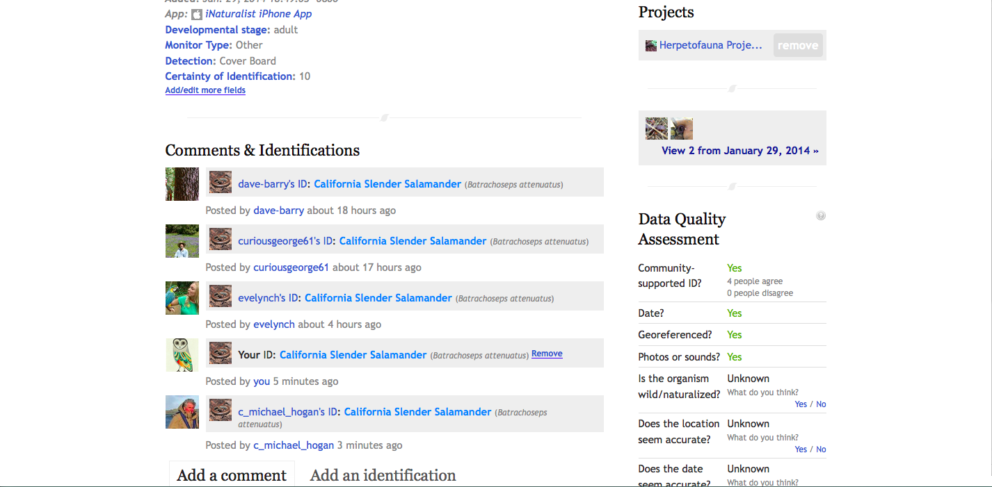
Photo ID Verification Process

Slide 19
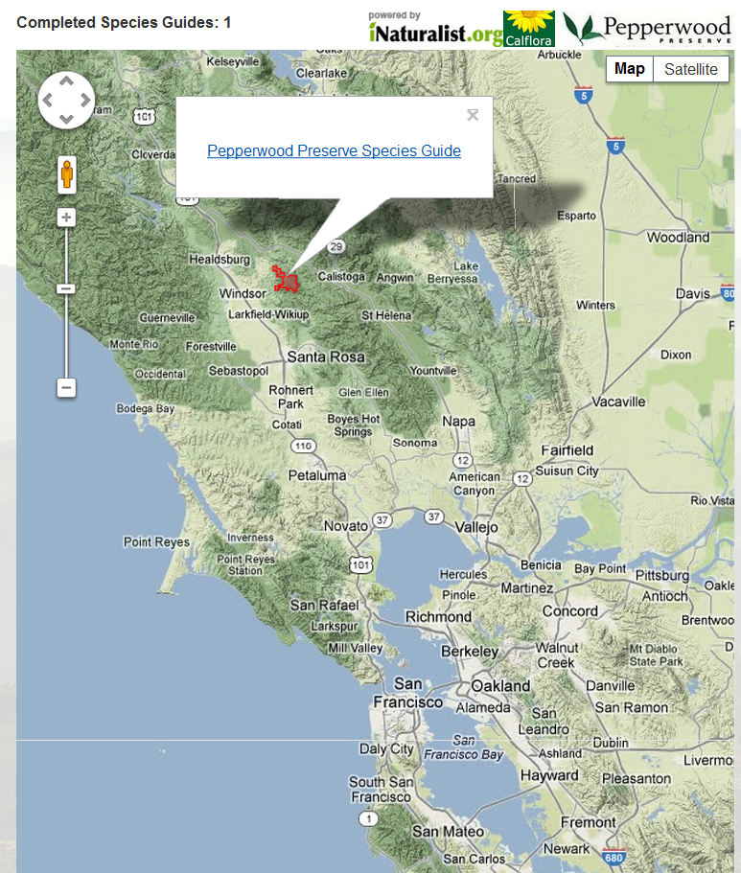
Service-learning
Generating valuable distribution data for conservationists
Building reserve level species guides where plant & animal species persist & where they are absent
A baseline for monitoring changes
The Bay Area BioAtlas
To view go to- http://www.bayarealands.org/take-action/bioatlas.php
Notes:
The distribution of the Bay Area's unique plants and animals are already shifting in response to land use andclimate change. As a baseline for monitoring these changes, the Bay Area BioAtlas seeks to build reserve-level Species Guides of where these plants and animals persist and where they are absent. The BioAtlasconsists of a network of participating reserves working together to assemble comprehensive, standardized checklists of all vertebrates, plants, butterflies, and dragonflies harbored within their boundaries. TheBioAtlas partners with iNaturalist's growing community of citizen scientists to collect new records, and coordinate with Calflora's library of 21,000 preserve checklists to ensure these valuable distribution data are available to conservationists. Explore the map to browse completed Species Guides.

Slide 20
Project Examples

Slide 21
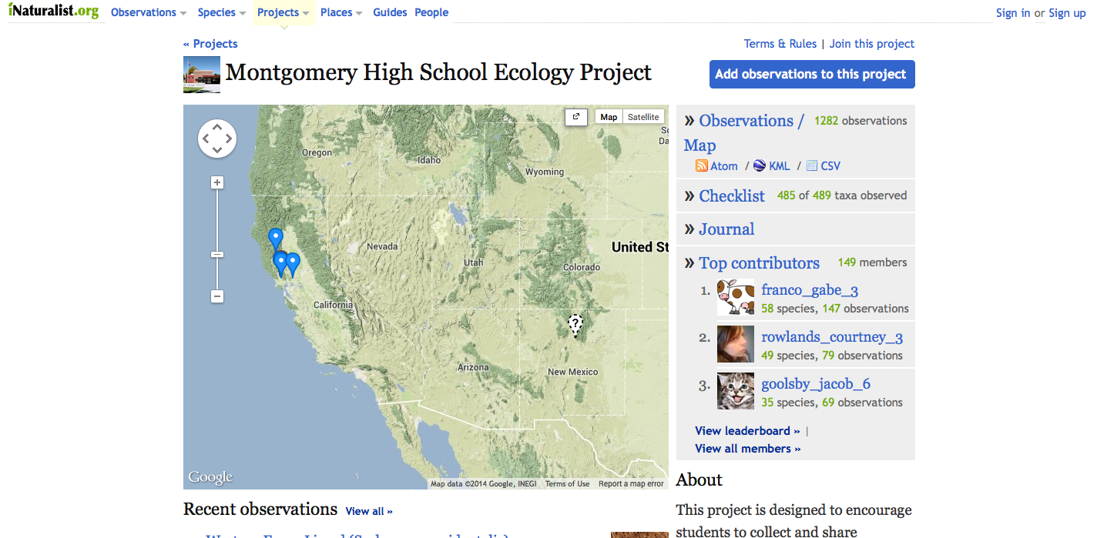
Montgomery High School’s
Ecology Project
www.inaturalist.org

Slide 22
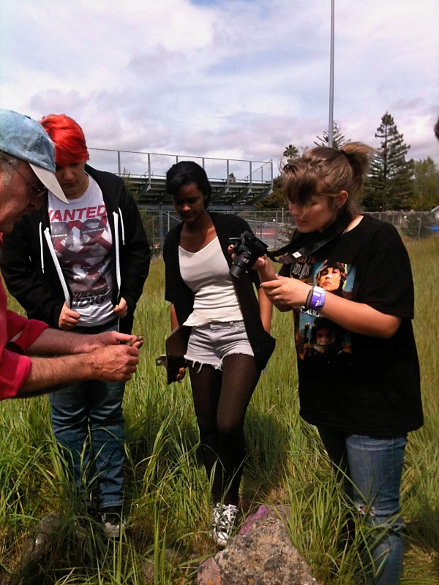
Julie Byrne
Julie Byrne-Wittmann

Slide 23
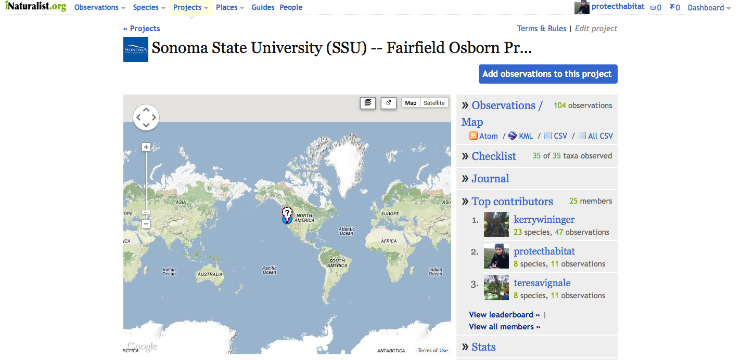
Sonoma State University’s
Fairfield Osborn Preserve Project
www.inaturalist.org

Slide 24
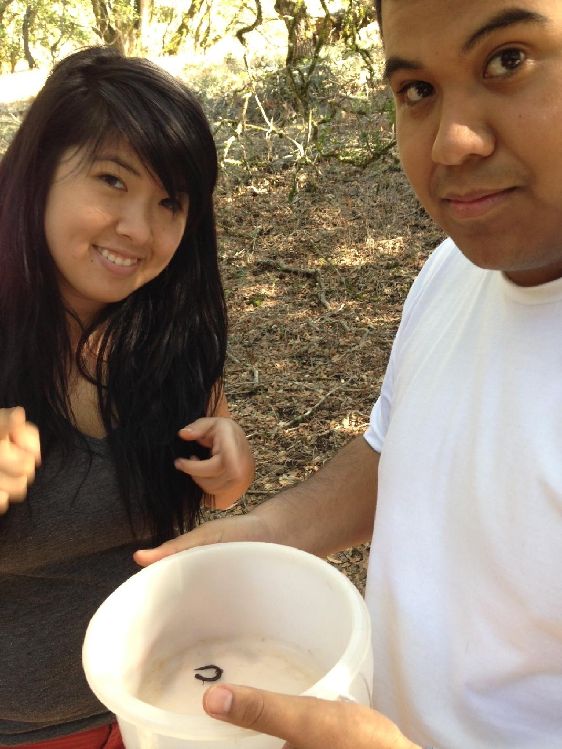
Julie Byrne-Wittmann

Slide 25
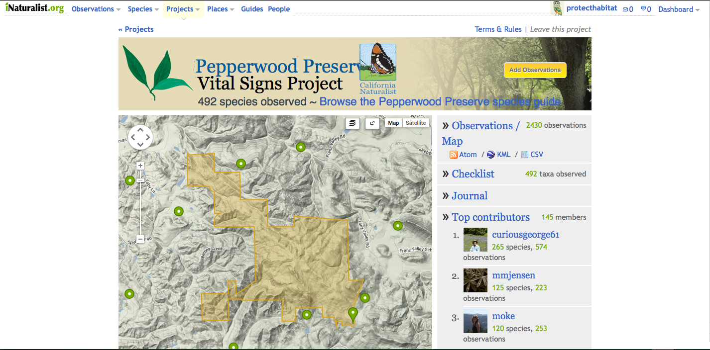
Pepperwood Preserve’s
Vital Signs Project
www.inaturalist.org

Slide 26
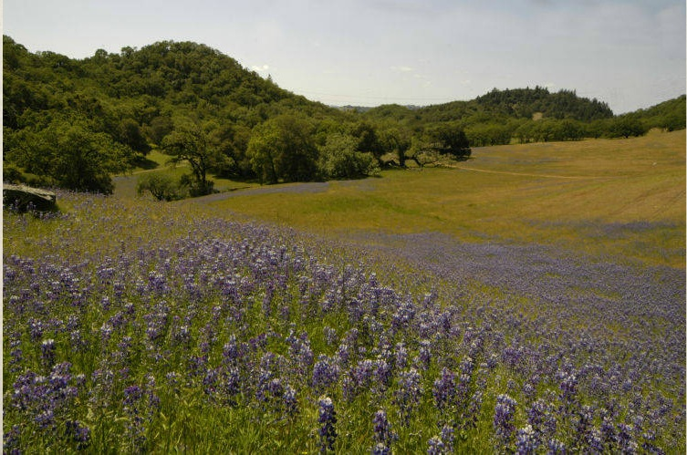
Greg Damron www.wildvinestudios.com

