Slide 1
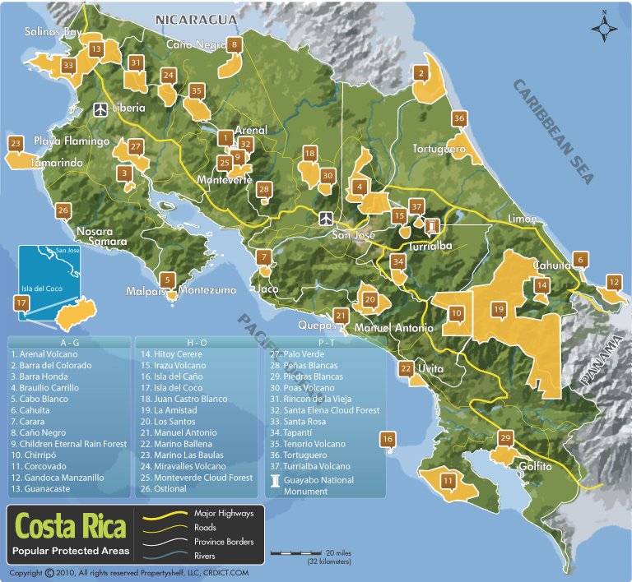
Brilliant Biodiversity Brains (aka Awesome Ecologists)
Notes:
Being a field ecologist, getting outside and really getting to know the biodiversity of a particular ecosystem, can be an amazing job. This is a profile of two such scientists who have done much of their work in the tropical forests of Costa Rica. Costa Rica is an incredible place. Only the size of West Virginia, (or only 0.01 percent of the world’s land mass,) it proudly holds and protects 5% of the world’s biodiversity – 5% of all species on Earth dwell here. The country has set aside 25% of its land in protected reserves and parks.

Slide 2
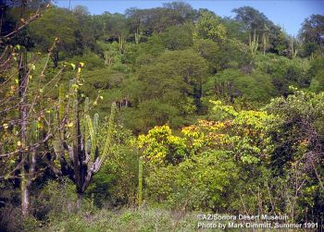
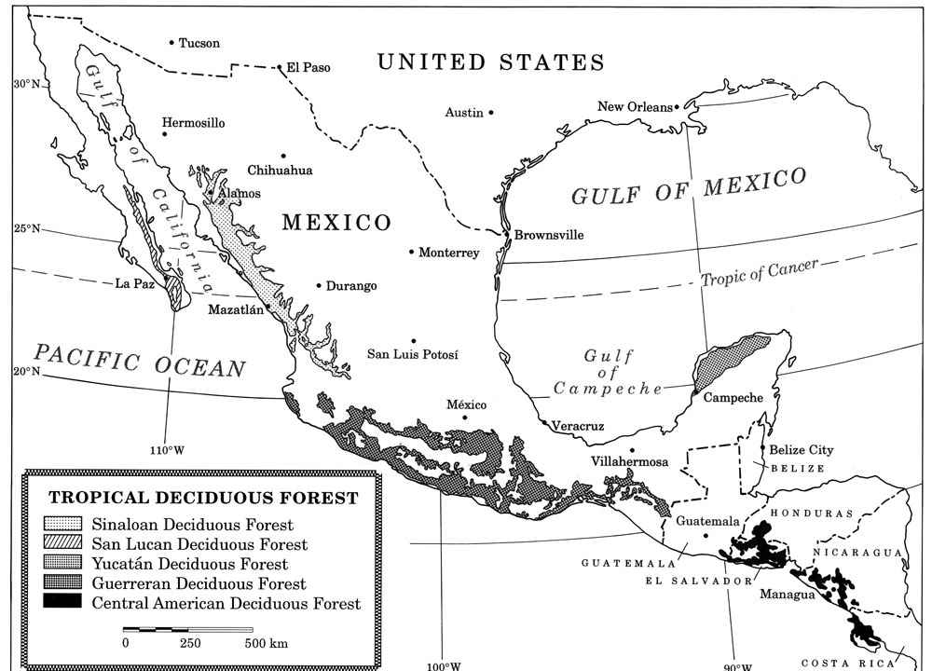
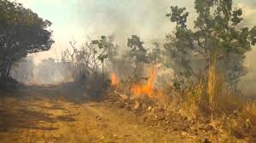
Tropical Deciduous Forest
Notes:
This is significant because tropical forests around the world are imperiled ecosystems with the encroachment of human development. One in particular is the Tropical Deciduous Forest or TDF. It extends from the southern edge of our desert in Sonora, Mexico to the Guanacaste Province of northwest Costa Rica. Since about half of the year the climate is dry and therefore makes the land easy to clear with fire, it has been highly exploited by people for agriculture and cattle production and is sometimes classified as the most threatened tropical ecosystem on Earth.

Slide 3
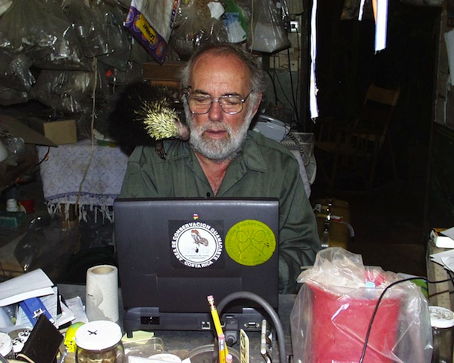
Dan Janzen
Notes:
Enter Daniel Janzen, a tropical ecologist and biodiversity conservationist with the University of Pennsylvania. In Costa Rica, the TDF was highly degraded, yet the government set about protecting a large portion of the Guanacaste Province of northwest Costa Rica. For the last 25 years, Dan Janzen has sought to unravel the mysteries of the entire ecological community there and, most importantly, restore the ecosystem back to health. He has 59 years of field experience and 466 scientific papers and books, all focused on the interactions of tropical animals and plants. Here he is in his office in Guanacaste with his pet porcupine Espinita.

Slide 4
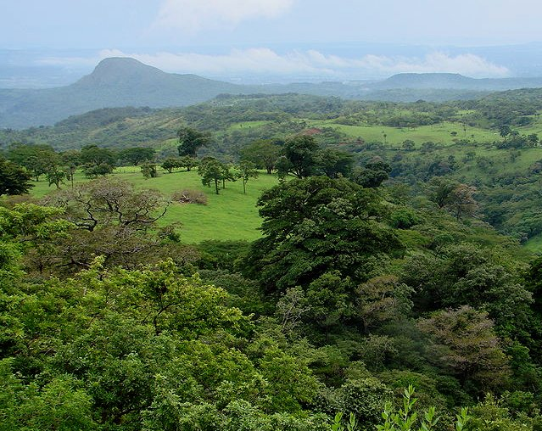
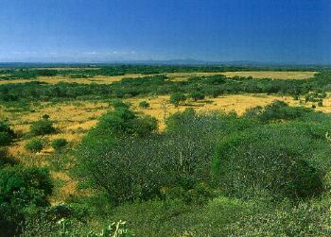
Guanacaste Conservation Area
Notes:
Working with the Costa Rican government and Nature Conservancy International, in 1985 Janzen helped the Costa Rican government to write off $25 million of its international debt in exchange for the degraded farmland in what has become the Area de Conservacion de Guanacaste (ACG), Guanacaste Conservation Area. It is a 250,000 acre wilderness area designated a national park by the government of Costa Rica. Today it is a wonderful example of restoration, of how to help a nearly destroyed ecosystem return to health.

Slide 5
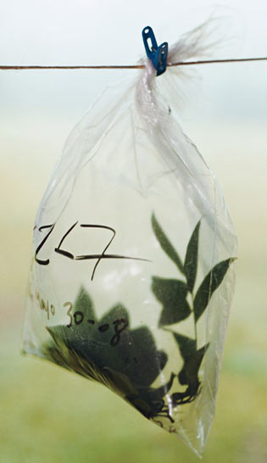
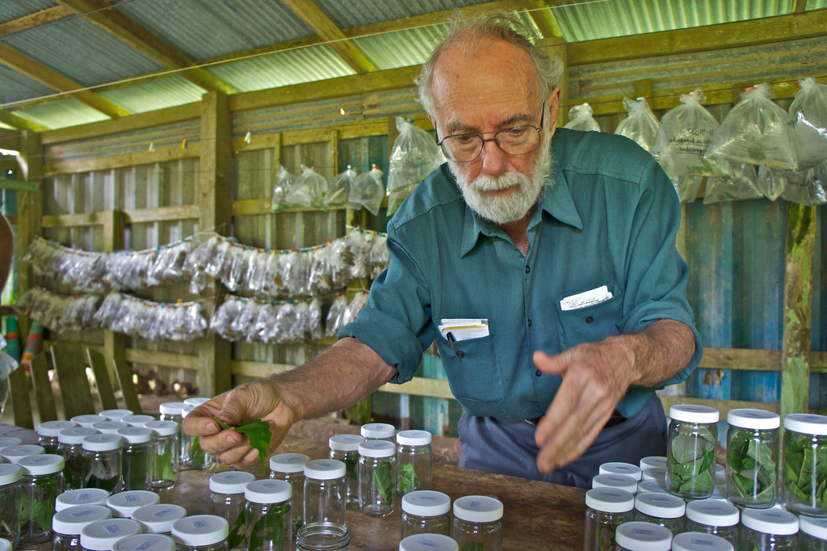
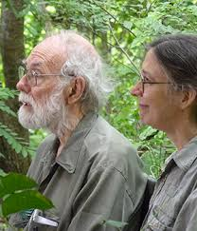
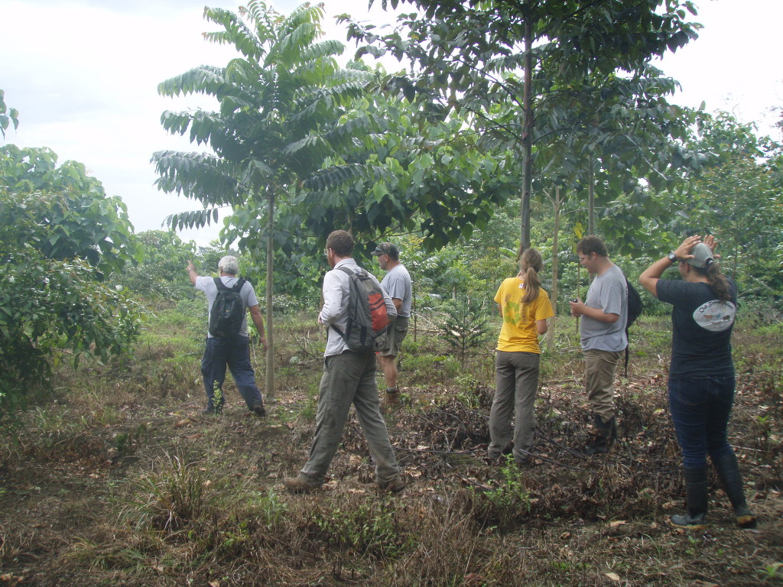
Notes:
As part of the process, Janzen and his fellow biologist and wife, Winnie Hallwachs, set about cataloguing and determining what actually lived there and how to bring it back. They work with local biologists to understand the life of the forest. The local people, who used to be cattle ranchers and farmers, are invested in protecting the land because they know that it has its own form of wealth intact instead of degraded.

Slide 6
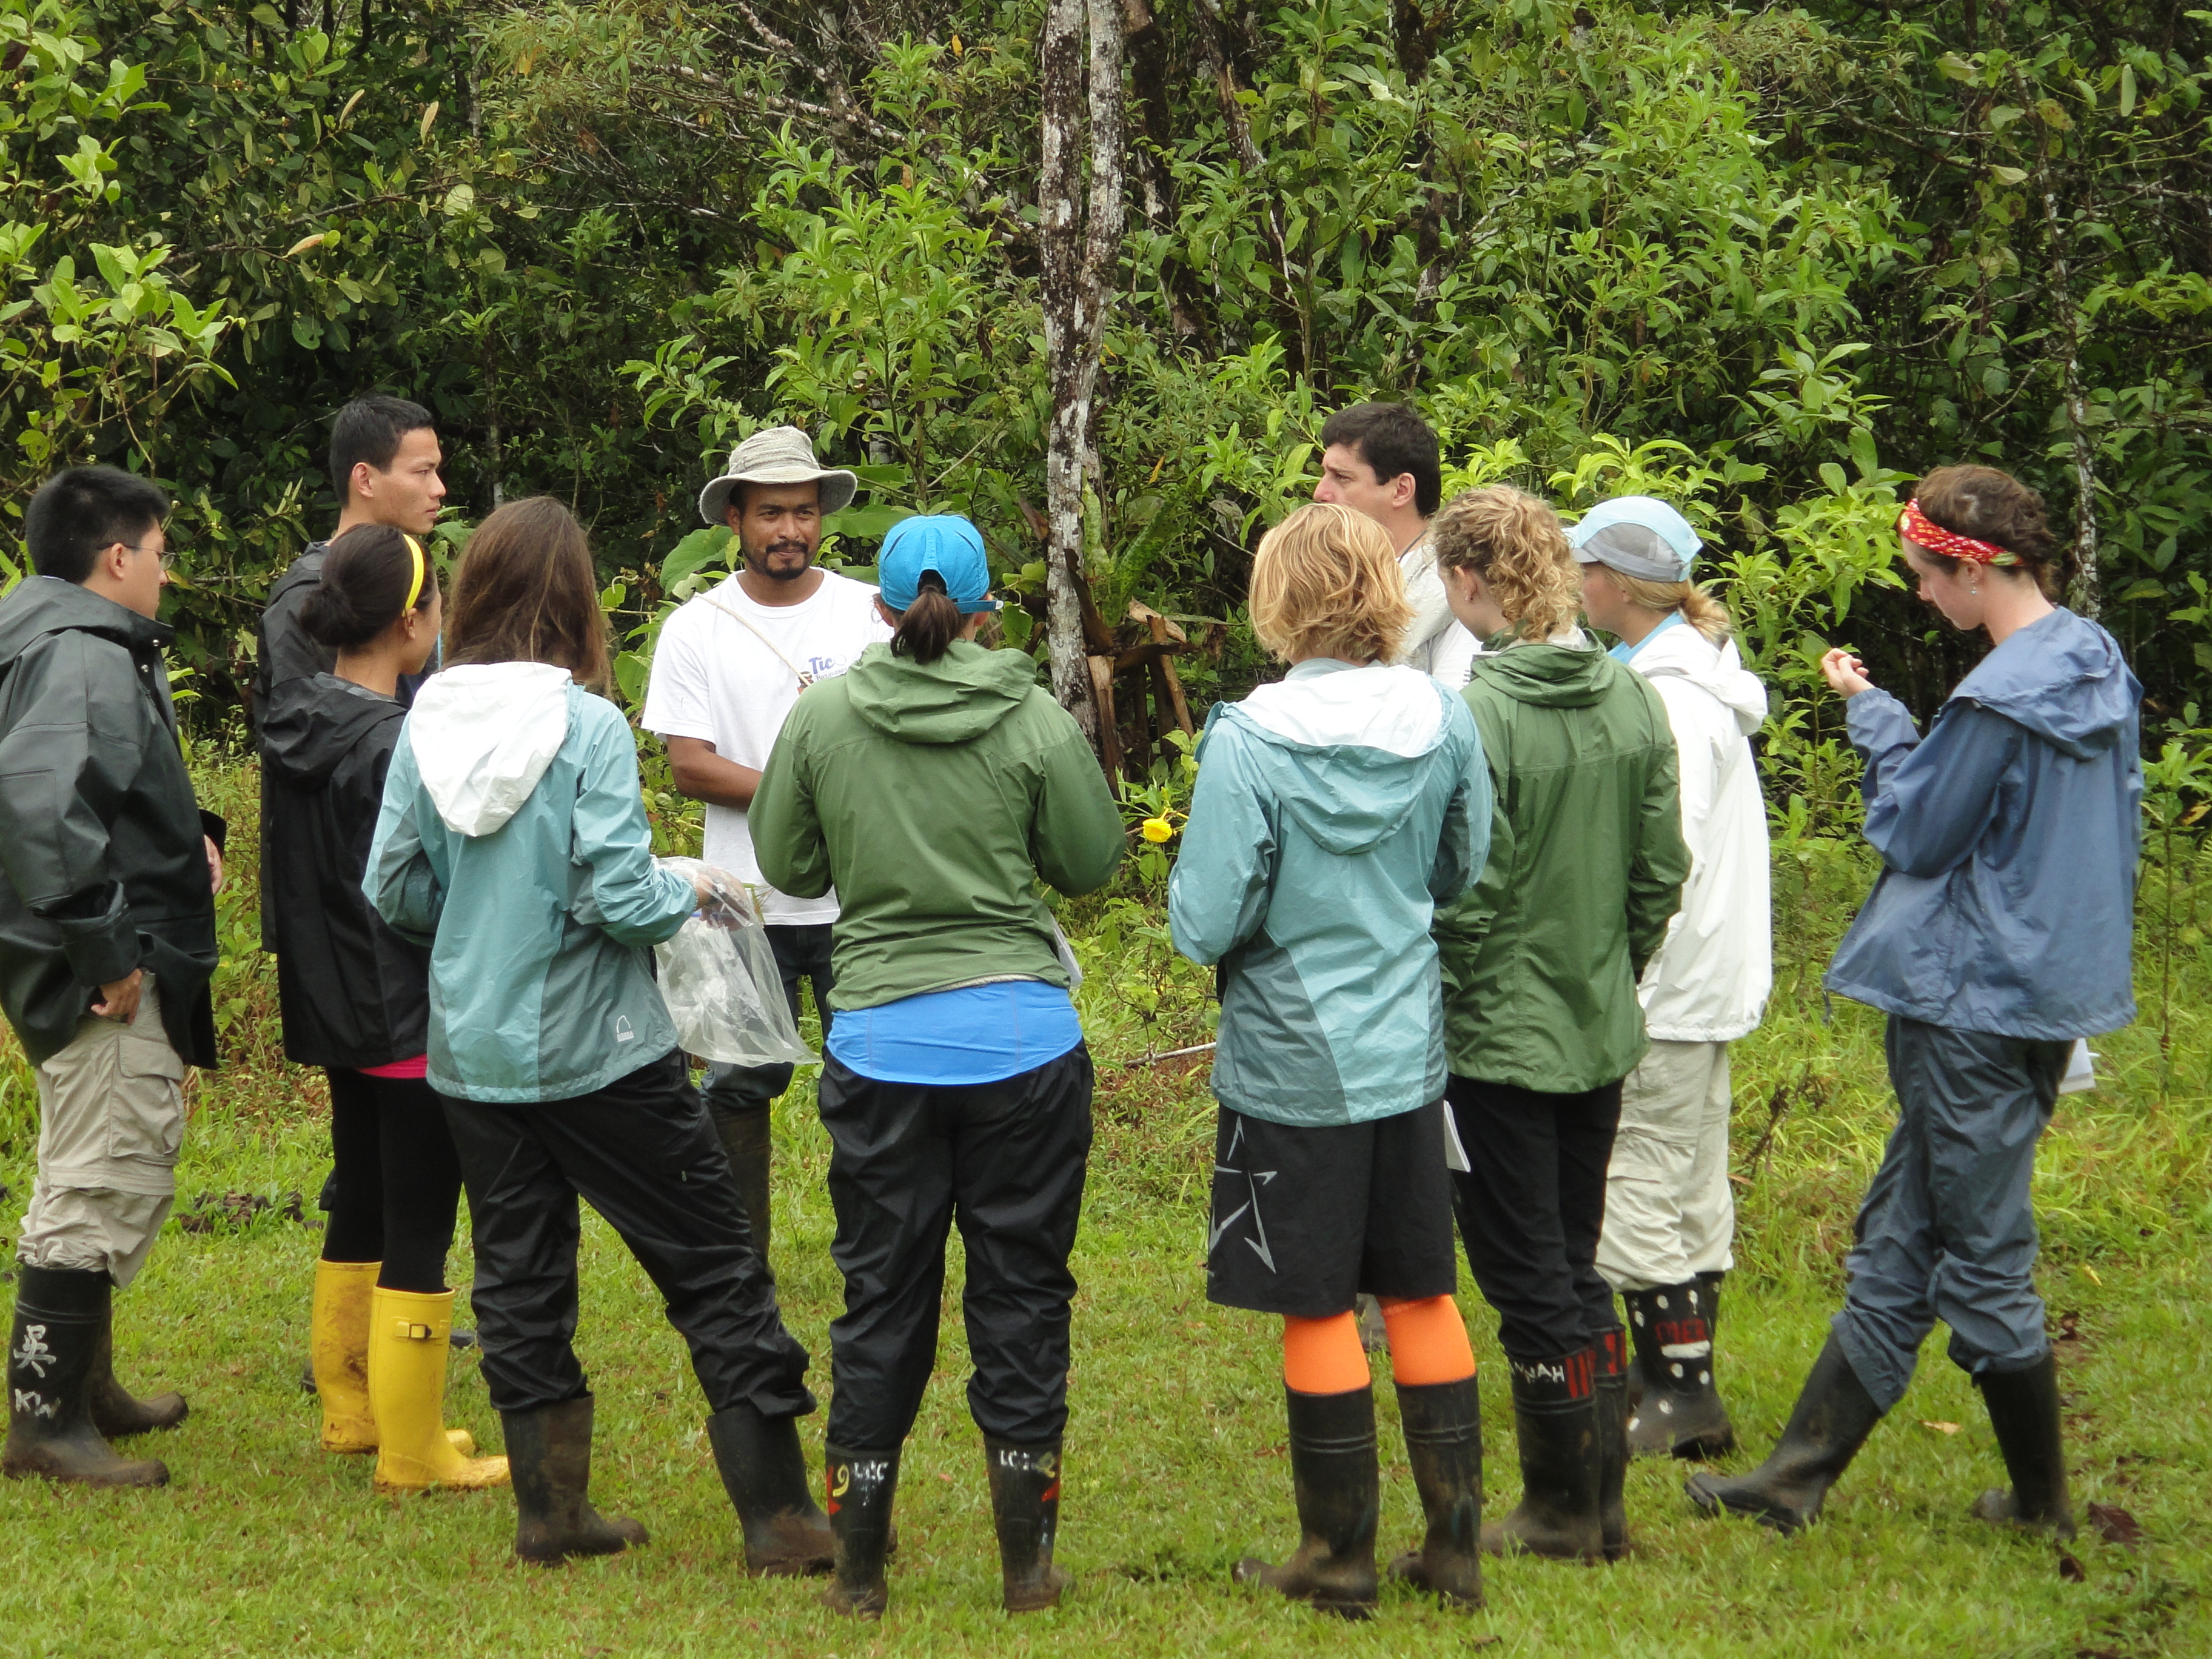
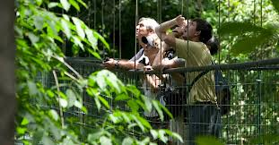
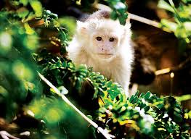
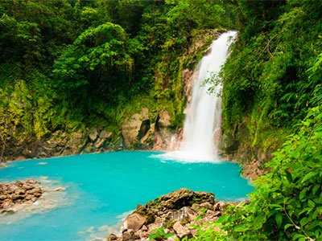
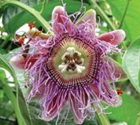
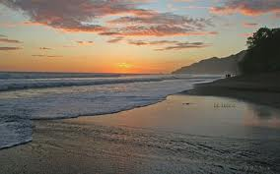
Notes:
Today some may view this as “wild” land, “undeveloped”, but it does produce important products: educational programs for students at all levels, ecotourism, pharmacological products for drug companies, and water for the entire region, just for a start. Dan Janzen and other ecological pioneers have helped an entire nation value its biodiversity, not just for the benefit of their nation, but the entire world.

Slide 7
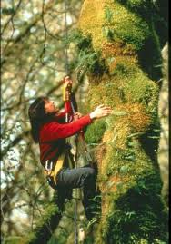
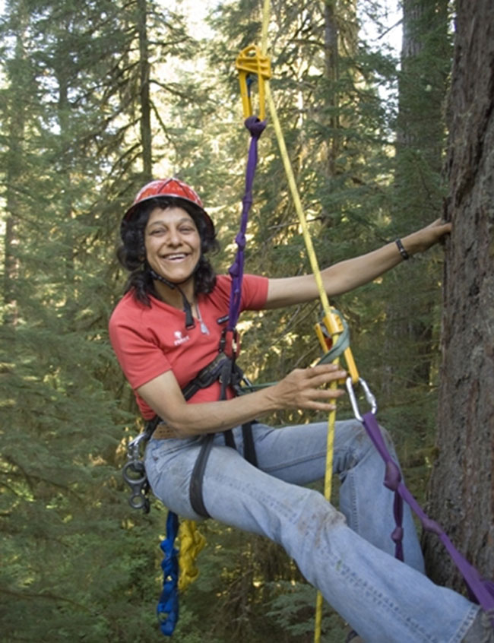
Nalini Nadkarni
Notes:
Another tropical ecologist who did work in Costa Rica has focused on the life in the trees. Nalini Nadkarni pioneered the study of rainforest tree canopies using mountaineering equipment to get up into the canopy and understand its little seen ecology.

Slide 8
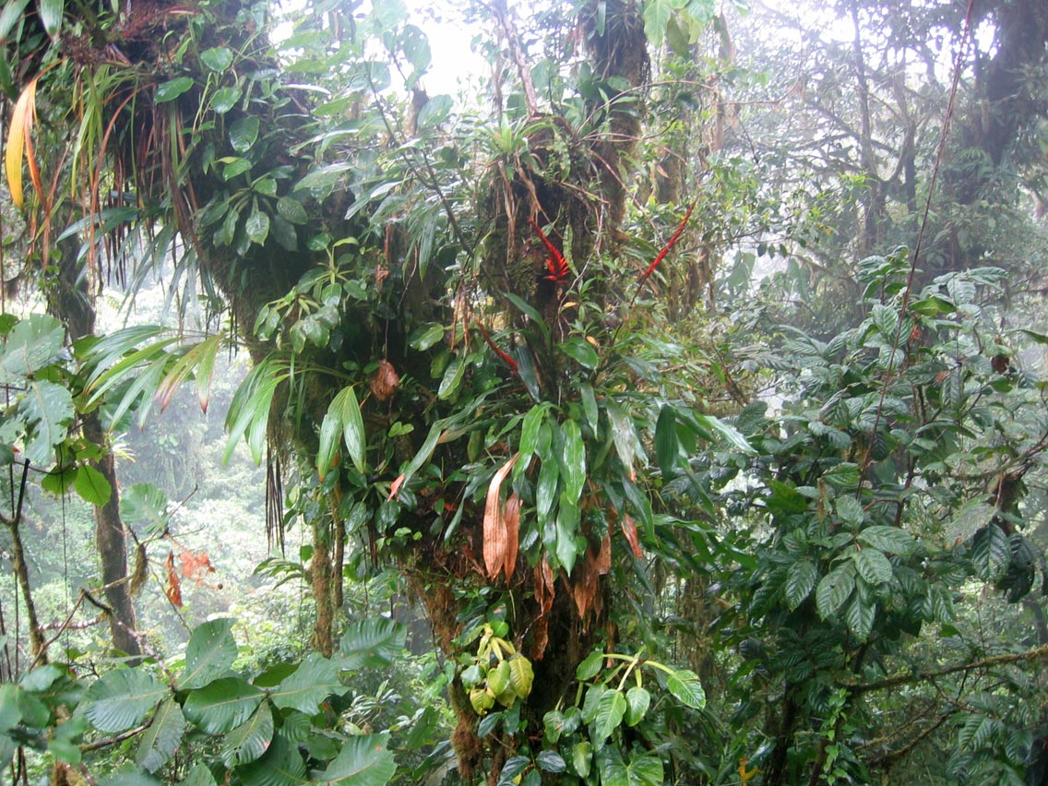
Unlocking the Mysteries of the Forest Canopy
Notes:
Rainforest canopies are filled with epiphytes, non-parasitic plants like orchids and ferns that anchor atop other plants and live a life aloft. Not much was known about them when Nalini decided to make her office high up in the trees. Nadkarni's interest was first drawn to rain forest ecology due to the contradiction offered by its plant life. There was a great abundance and variety of plant life within the rain forest despite its nutrient poor soil, and her goal was to discover how the plant life was sustained. Her studies within the canopy revealed that the epiphytes were trapping organic material beneath their root system. This organic material eventually formed a nutrient rich mat, and trees in the rain forest had developed aerial roots, stemming from their trunks and branches, in order to absorb these nutrients as well. The aerial roots growing into the mats aided the rain forest trees by providing the nourishment that they did not receive from the nutrient poor soil.

Slide 9
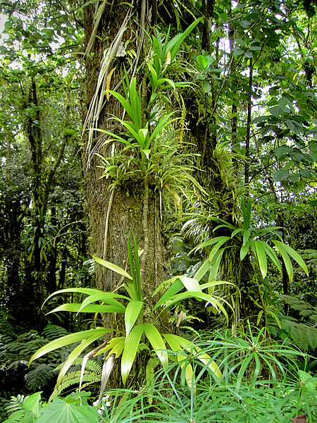
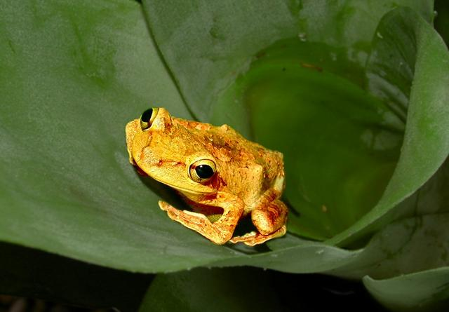
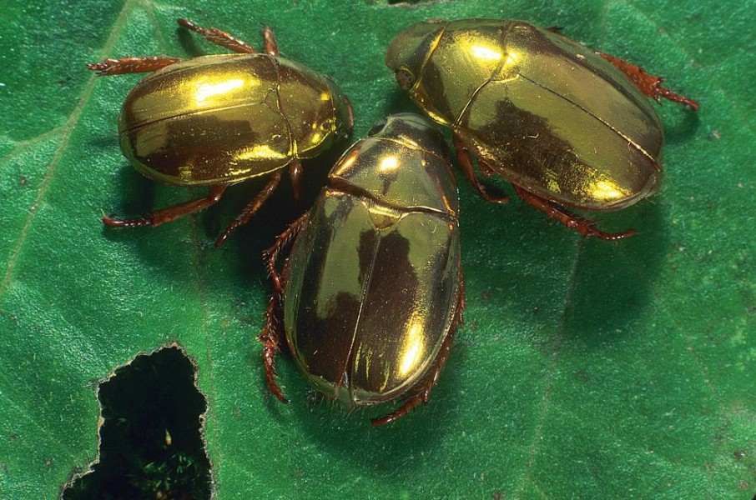
Unlocking the Mysteries of the Forest Canopy
Notes:
Not only do epiphytic mats provide nourishment to their platforms, but they provide habitat for a huge diversity of life forms from insects to vertebrates.

Slide 10
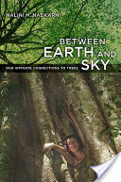
Inspiring Others
Notes:
As a researcher and professor, Nalini has described the connections between plants and the ecosystem and inspired many students to understand the incredible complexity of forest ecosystems both at Evergreen State College and now at the University of Utah, as well as the public through her TED talks and publications. Getting grubby in the forest can be a great profession!

