Slide 1
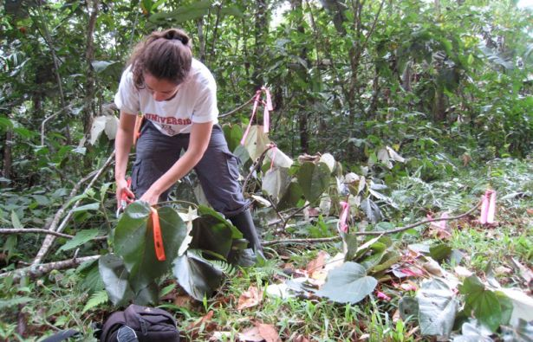
Measuring Plant Biodiversity
From: http://uanews.org/story/biodiversity-is-more-than-just-a-numbers-game
Notes:
In addition to measuring the biodiversity of animals in an ecological community, ecologists and resource managers quantify plant biodiversity.

Slide 2
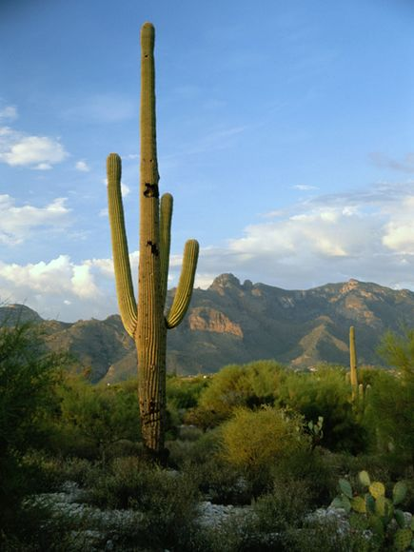
Species Diversity
Why Measure Plant Diversity?
Notes:
Plant biodiversity is often measured because high biodiversity is synonymous with ecosystem health. In general, diverse communities have increased stability, increased productivity, and resistance to invasion and other disturbances. Measurements over time and comparison among plots allows scientists to understand changes that may have occurred because of a natural or human caused disturbance (e.g., similarity between burned and unburned sites)? (From: http://www.webpages.uidaho.edu/veg_measure/Modules/Lessons/Module%209%28Composition&Diversity%29/9_2_Biodiversity.htm)
Why? Diversity is measured for three main reasons: (1) to measure stability to determine if an environment is degrading, (2) to compare two or more environments, and (3) to eliminate the need for extensive lists. Diversity indices provide important information about the composition of a community. https://en.wikibooks.org/wiki/Ecology/Species_Richness_and_Diversity
Photo on left from: http://environment.nationalgeographic.com/environment/habitats/sonoran-desert/

Slide 3
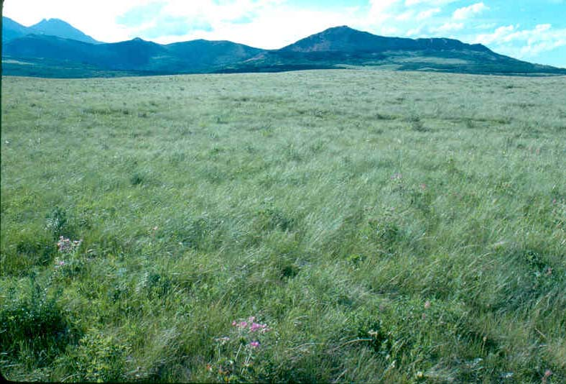
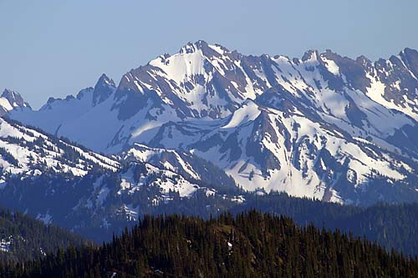
Ecosystem Diversity
How to Measure Plant Diversity?
Notes:
There is a vast array of sampling approaches, designs and field techniques for measuring plant diversity. How would you approach measuring plant communities in these varied ecosystems? You couldn’t use the same approach for each site, but the same basic questions and techniques hold true.

Slide 4
Species Diversity
What Aspects are Measured?
Richness (the number of species)
+ Abundance (proportion of these species)
Plot 1 Plot 2
Notes:
Plant diversity seems like a simple thing to measure, simply count the number of species, right? Well, yes and no. For example, say there are two sites that each contain 10 plant species. In one site, two of those species account for 90% of the total plant community with the other 8 species being present at very low levels, while in the other site, all 10 species are about equally abundant. Do these sites have the same diversity?
Species richness is the number of different species represented in an ecological community, landscape or region.^{[1]} Species richness is simply a count of species, and it does not take into account the abundances of the species or their relative abundance distributions. Species diversity takes into account both species richness and species evenness or abundance. https://en.wikipedia.org/wiki/Species_richness
Plant biodiversity is a combined measure of richness (the number of species) and evenness or abundance (proportion of those species) present at a site.

Slide 5
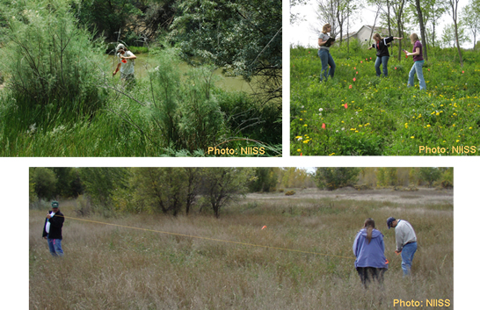
Species Diversity
Choosing a Plot
What types of plants?
How large of an area?
10 x 10 meters
Notes:
It is important when choosing a plot that it has random sampling and large enough sampling to get an accurate representation of an area’s diversity. A common plot size for sampling vegetation is 10 x 10 meters, which is large enough for sampling trees and understory plants, but not so large as to be difficult to sample or replicate. There is no magic size that is inherently better than another. You want to select a plot size that is large enough to capture some of the variability in your plant community (usually at least 1m2 for understory plants), but not so large that it becomes impractical. The size and distribution of the particular plants of interest also affect the plot size. For example, if you are sampling trees, you need a much larger plot than if you are only sampling small understory plants. Sometimes it is necessary to use one sized plot for some plants (like trees) and another size plot for others (like understory plants). Perhaps more important than the size of the plots, is the total area sampled. You want to sample enough plots so that the total area sampled accurately captures the composition and diversity of the plant community of interest. (from http://greatlakeswormwatch.org/research/methods_plants.html) Photos from: http://collaborativescience.org/DH.php?WC=/WS/CitSci/Tutorials_Wisconsin/Tutorial3_Static.html

Slide 6
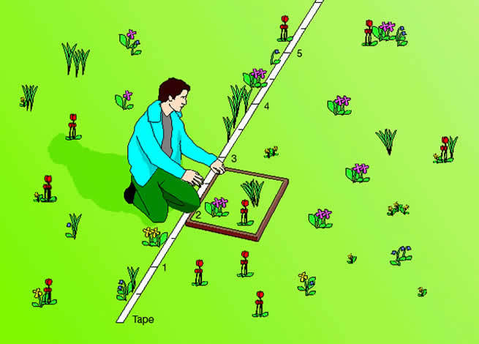
Species Diversity
Plot Design: Transects
Notes:
A common field technique for measuring species in a plot is a transect. A transect is a path along which one counts and records occurrences of the species of study (e.g. plants). It requires an observer to move along a fixed path and to count occurrences along the path and, at the same time (in some procedures), obtain the distance of the object from the path. This results in an estimate of the area covered and an estimate of the way in which detectability increases from probability 0 (far from the path) towards 1 (near the path). Using the raw count and this probability function, one can arrive at an estimate of the actual density of objects.
Image: http://www.glogster.com/kcsrobinson/transects-and-quadrats/g-6lkq4n0hhfsbekt2vtbr6a0

Slide 7
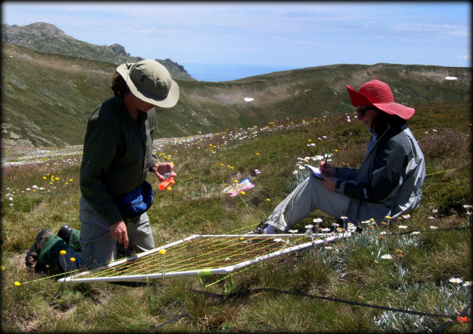
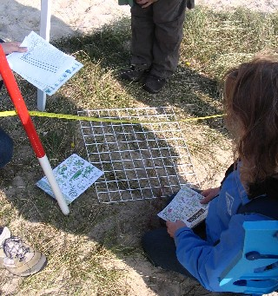
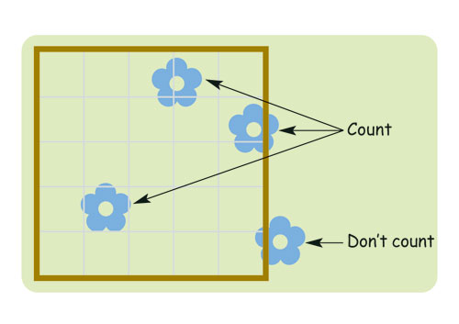
Species Diversity
Plot Design: Quadrats
Notes:
Along a transect, quadrats can be used to measure specific characteristics within a plot. Quadrats are a defined grid of a number of squares (10 X 10 or another even dimension) that allow easy approximation of percent cover.
Image on top on right from http://www.rgs.org/OurWork/Schools/Fieldwork+and+local+learning/Fieldwork+techniques/Ecosystems.htm
Image on left from: http://ianluntecology.com/2013/12/01/is-plant-diversity-on-the-skids-the-scales-of-biodiversity-loss/

Slide 8
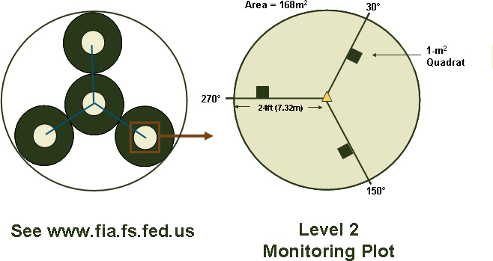
Species Diversity
Plot Design: Multi-scale Plots and Subplots
Notes:
The main goal is to be sure to get a sampling that is random enough to be a true representation of the area, and large enough to capture species abundance.
This plot design is a modification of the US Forest Service's Forest Inventory and Analysis (FIA) monitoring plot. This plot design has been used by the Forest Service since 1995 to collect, analyze, and report information on the status, trends, and conditions of forests nationwide. The monitoring program consists of a uniform distribution of sample plots across all 50 states. If you are interested, you can visit the USFS FIA program's website at www.fia.fs.fed.us for more information. The monitoring plot is a multi-scale plot consisting of four 168 m2 subplots, each with three additional 1-m2 subplots. For the Level 2 monitoring protocol, only one of the four 168 m2 subplots are used with three 1-m2 subplots.
From: http://collaborativescience.org/DH.php?WC=/WS/CitSci/Tutorials_Wisconsin/Tutorial3_Static.html

Slide 9
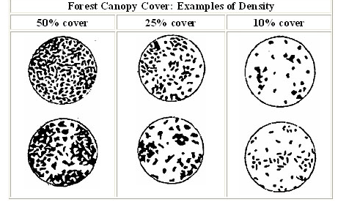
Species Diversity
Measuring Abundance – Cover
From: hwwff.cce.cornell.edu
The ACFOR scale for measuring species abundance
A = ABUNDANT (greater than/equal to 30%)
C = COMMON (20 to 29%)
F = FREQUENT (10 to 19%)
O = OCCASIONAL (five to nine per cent)
R = RARE (one to four per cent)
From: www.rgs.org/OurWork/Schools/Fieldwork+and+local+learning/Fieldwork+techniques/Ecosystems.htm
Notes:
Sampling plant abundance
When measuring plant abundance, you look at the density of a species or plant type within a measured area. If you wanted to know how abundant plants are in a plot, you could simply go in and count stems or individuals in that plot. Stem counts are accurate when determining the population size of a particular plant species, but can be time consuming in areas with dense plant communities. Plus it is always a challenge to figure out how to count clonal species like grasses that have many stems for each individual. Also, individuals of different species can vary a lot in size! For example, when using stem counts, a small violet is counted the same as a very large fern. When examining plant population dynamics within species, stem counts are the way to go. But when looking at overall plant communities, sometimes a measure of “how much space” a particular species occupies is a valuable thing to know. That’s where percent cover can be helpful. Percent cover is a method of determining relative abundance based on the amount of space they take up. In this method, rather than counting the number of individuals you assign each species to a “percent cover class” based on a visual estimate of how much of the sample plot they occupy.
ACFOR scale: In our invasive species monitoring program here at ASDM, we used a common method of assessing % cover, the ACFOR scale above. Variations of this approach for measuring plant abundance include stem counts and percent cover. Each has their pro’s and con’s. Depending on the questions you are asking, sometimes it is desirable to use both.

Slide 10
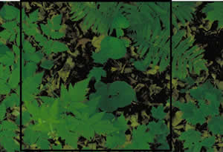
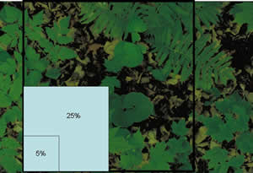
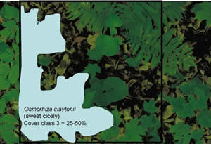
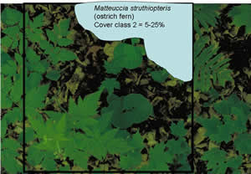
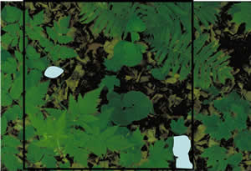
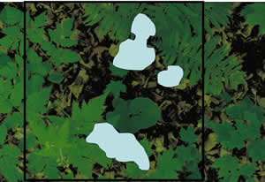
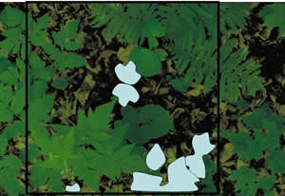
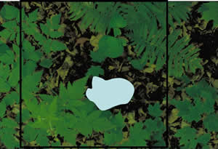
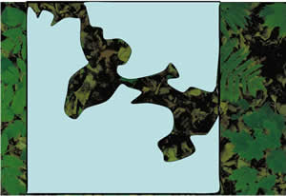
Species Diversity
Measuring Abundance – Percent Cover
From: hwwff.cce.cornell.edu
Notes:
Using quadrats is a very effective way to determine percent cover. Percent cover is reliable measure of plant abundance in a plot. It is a method of determining relative abundance based on the amount of space plants take up. In this method, rather than counting the number of individuals you assign each species to a “percent cover class” based on a visual estimate of how much of the sample plot they occupy. The reason most scientists use cover classes, rather than assigning a species number, like 16% or 48%, is that most people would not select the same number if they were looking at the same sample plot, it’s just too subjective. However, research has shown that most of the time, most people will select the same cover class when looking at the same sample plot, so it is a more reliable measure of plant abundance. http://greatlakeswormwatch.org/research/methods_plants.html

Slide 11
Species Diversity
Calculating Diversity: Diversity Indices
Shannon Index
Simpson Index
Renyi Entropy
Berger-Parker Index
Notes:
There are many indicies that can be used to calculate diversity. These are some of the more valuable indicies that calculate diversity. Each of the indicies uses different mathematical approaches to calculate diversity between two or more communities. From: https://en.wikibooks.org/wiki/Ecology/Species_Richness_and_Diversity and https://en.wikipedia.org/wiki/Diversity_index
Many of us shut down when we see numbers represented in this way, and that’s why we want to talk more about ways to make biodiversity math relevant to the classroom.

Slide 12
Species Diversity
Measuring Biodiversity: Curricula
American Museum of Natural History: Students learn to calculate the biodiversity index for a site. They calculate the number of species in an area and divide them by the total number of individuals to get the index. http://www.amnh.org/explore/curriculum-collections/biodiversity-counts
Association of Fish and Wildlife Agencies: Schoolyard Biodiversity Investigation Educator Guide. (Gr. 4) http://www.fishwildlife.org/files/ConEd-Schoolyard-Biodiversity-Guide.pdf
National Wildlife Federation: Biodiversity Curriculum Connections: A comprehensive list of resources for teaching biodiversity to grades K – 12. http://www.nwf.org/Eco-Schools-USA/Become-an-Eco-School/Pathways/Biodiversity/Curriculum.aspx
National Institutes of Invasive Species Science: Monitoring protocols and methods outlined for use with older students. http://collaborativescience.org/DH.php?WC=/WS/CitSci/Tutorials_Wisconsin/Tutorial3_Static.html
Notes:
Others:
Royal Geographic Society in Britain has some simple, clear field techniques for comparing landscape types and plant communities on them: http://www.rgs.org/OurWork/Schools/Fieldwork+and+local+learning/Fieldwork+techniques/Ecosystems.htm
http://www.amnh.org/explore/curriculum-collections/biodiversity-counts
http://www.wikihow.com/Measure-Biodiversity-for-a-College-Field-Project
http://www.gaeppc.org/curriculum/activity11.pdf
http://www.nuffieldfoundation.org/practical-biology/biodiversity-your-backyard

