Slide 1
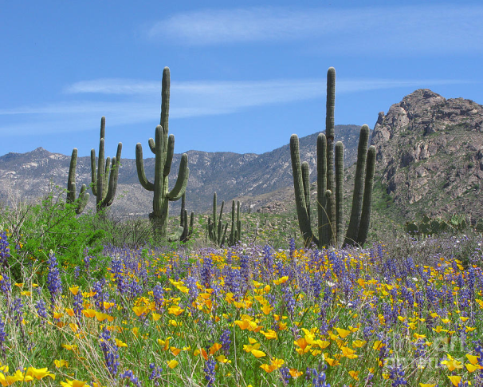
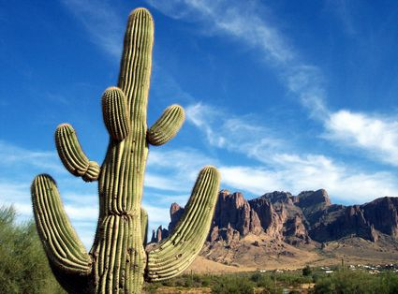
Schoolyard Biodiversity Inventories Program

Slide 2
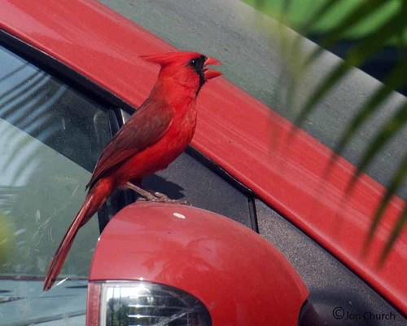
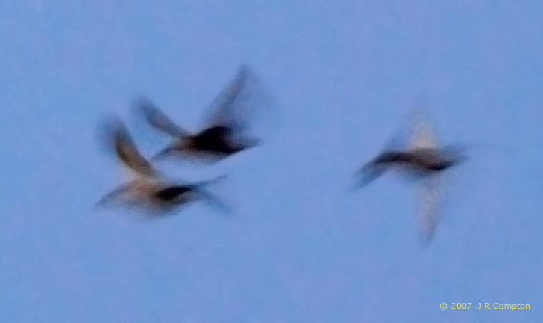
What makes a good observation?
Pros
Cons
Detailed description
Clear photograph
Location
Vague description
Blurry photograph
Object is too far away

Slide 3
How to use iNaturalist

Slide 4
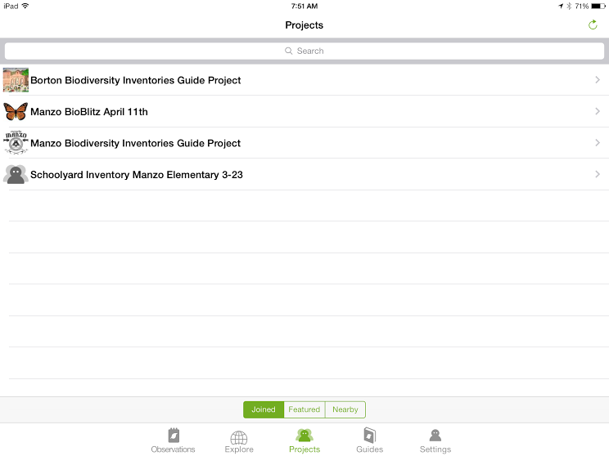
iNaturalist Projects

Slide 5
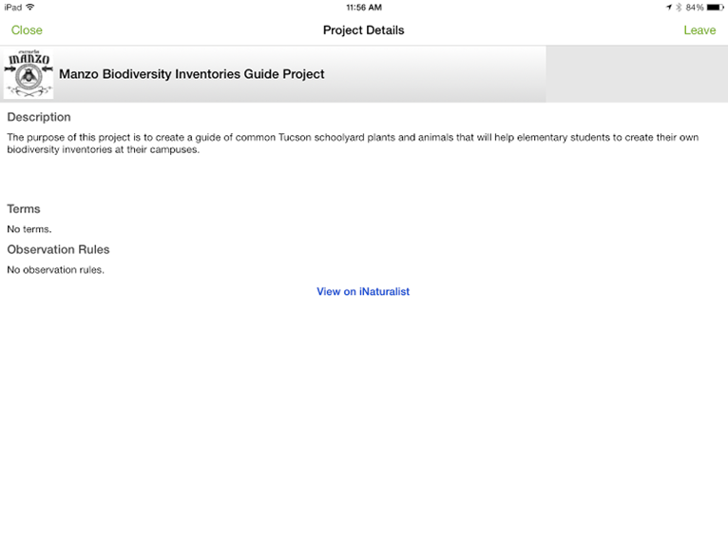

Slide 6
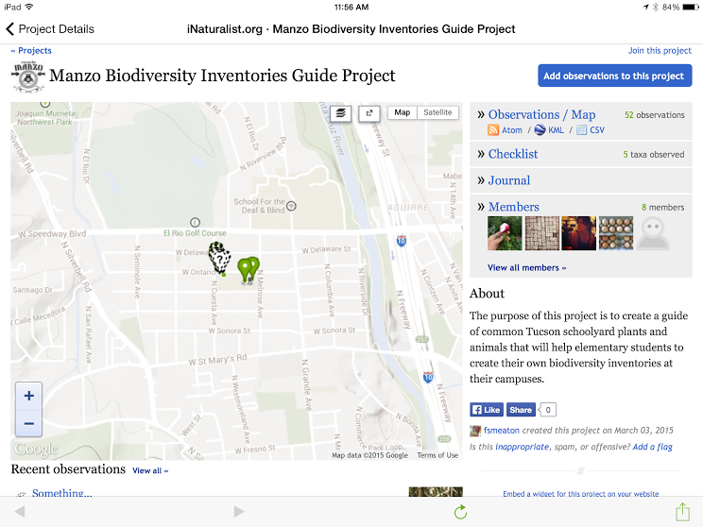

Slide 7
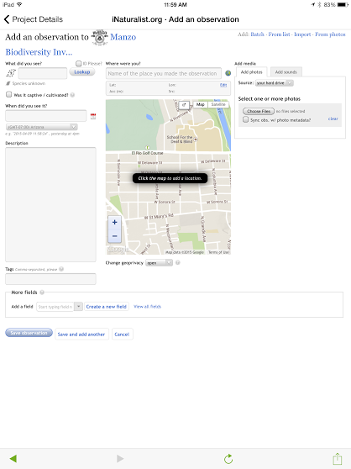
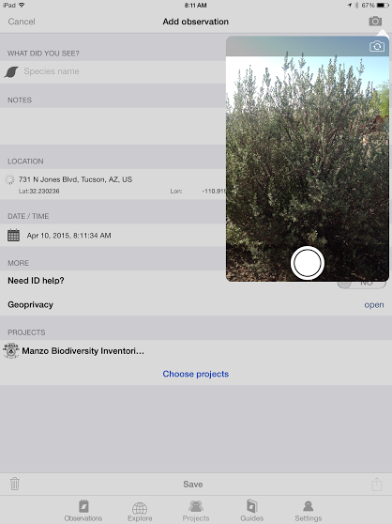

Slide 8
Questions?

